Slide 1
Boolean Algebra and Logic Gates
Chapter 2

Slide 2





Basic Definitions
Boolean Algebra defined with a set of elements, a set of operators and a number of axioms or postulates.
A set if a collection of objects having a common property
Elements
x is an element of set S
y is not an element of set S
* Binary operator and result c of operation on a and b is an element of set S

Slide 3
Basic Definitions
Closure: A set S is closed with respect to a binary operator if, for every pair of elements of S, the binary operator specifies a rula for obtaining a unique element of S.
Associative law: (x*y)*z=x*(y*z) for all z, y, z ЄS.
Commutative law: x*y=y*x
Identity Element: e*x=x*e=x
Inverse: A set S having the identity element e with respect to binary operator * is said to have an inverse whenever, for every xЄS, there exists an element y such that x*y=e
Distributive law: If * and . are binary operators on S, * is said to be distributive over . whenever x*(y.z)=(x*y).(x*z)

Slide 4
Basic Definitions
A field is an example of an algebraic structure.
A field is a set of elements, together with two binary operators, each having properties 1-5 and both combining to give property 6.

Slide 5
Axiomatic Definition of Boolean Algebra
Boolean algebra is an algebraic structure defined by a set of elements, B, together with binary operators + and .
(a) The structure is closed with respect to +
(b) The structure is closed with respect to .
(a) The element 0 is an identity element with respect to +
(b) The element 1 is an identity element with respect to .
(a) The structure is commutative with respect to +
(b) The structure is commutative with respect to .
(a) The operator . is distributive over +
(b) The operator + is distributive over .
For every element xЄB, there exists an element x’ЄB called the complement of x such that (a) x+x’=1 and (b) x.x’=0
There exist at least two elements x, yЄB such that x≠y

Slide 6

Two-valued Boolean Algebra
Defined on a set of two elements
x | y | x.y
0 | 0 | 0
0 | 1 | 0
1 | 0 | 0
1 | 1 | 1
x | y | x+y
0 | 0 | 0
0 | 1 | 1
1 | 0 | 1
1 | 1 | 1
x | x’
0 | 1
1 | 0

Slide 7
Two-valued Boolean Algebra
x | y | z
0 | 0 | 0
0 | 0 | 1
0 | 1 | 0
0 | 1 | 1
1 | 0 | 0
1 | 0 | 1
1 | 1 | 0
1 | 1 | 1
y+z | x.(y+z)
0 | 0
1 | 0
1 | 0
1 | 0
0 | 0
1 | 1
1 | 1
1 | 1
x.y | x.z | (x.y)+(x.z)
0 | 0 | 0
0 | 0 | 0
0 | 0 | 0
0 | 0 | 0
0 | 0 | 0
0 | 1 | 1
1 | 0 | 1
1 | 1 | 1

Slide 8
Basic Theorems and Property of Boolean Algebra
Duality:
Exchange parts (a) and (b) of Boolean Algebra (operators and identity element) and postulates remain valid
In two valued Boolean Algebra identity elements of set B are the same: 1 and 0; interchange 1’s by 0’s and 0’s by 1’s and interchange OR and AND operators.

Slide 9
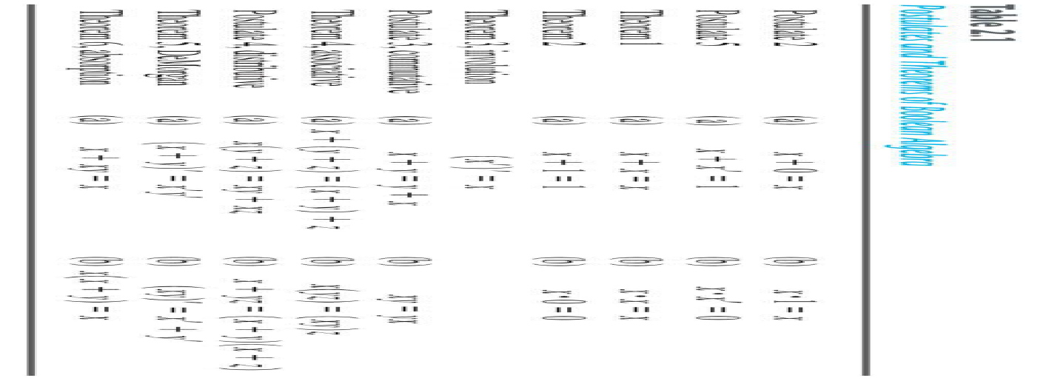
Basic Theorems

Slide 10






Theorem 1(a)
but
thus
Distributing + over . gives in general
Replace x by x’

Slide 11





Theorem 1(b)
It can be proved by duality of Theorem 1(a)

Slide 12






Theorem 2(a)

Slide 13

Theorem 2(b)
By duality of Theorem 2(a)

Slide 14





Theorem 3
and
Both equations define the complement
The complement of
is
and is also
Since the complement is unique

Slide 15




Theorem 6(a) Absortion

Slide 16

Theorem 6(b) Absortion
By duality of Theorem 6(a)

Slide 17
Theorem 6(a) Absortion
Proof by truth table
x | y
0 | 0
0 | 1
1 | 0
1 | 1
xy | x+xy
0 | 0
0 | 0
0 | 1
1 | 1

Slide 18
DeMorgan’s Theorem
Proof by truth table
x | y | x+y | (x+y)’
0 | 0 | 0 | 1
0 | 1 | 1 | 0
1 | 0 | 1 | 0
1 | 1 | 1 | 0
x' | y' | x‘y’
1 | 1 | 1
1 | 0 | 0
0 | 1 | 0
0 | 0 | 0

Slide 19
Operator precedence
Parenthesis
NOT
AND
OR

Slide 20


Boolean Functions
A Boolean functions described by an algebraic expression consists of binary variables, the binary constants 0 and 1, and the logic operation symbols
Do the truth tables for these functions

Slide 21
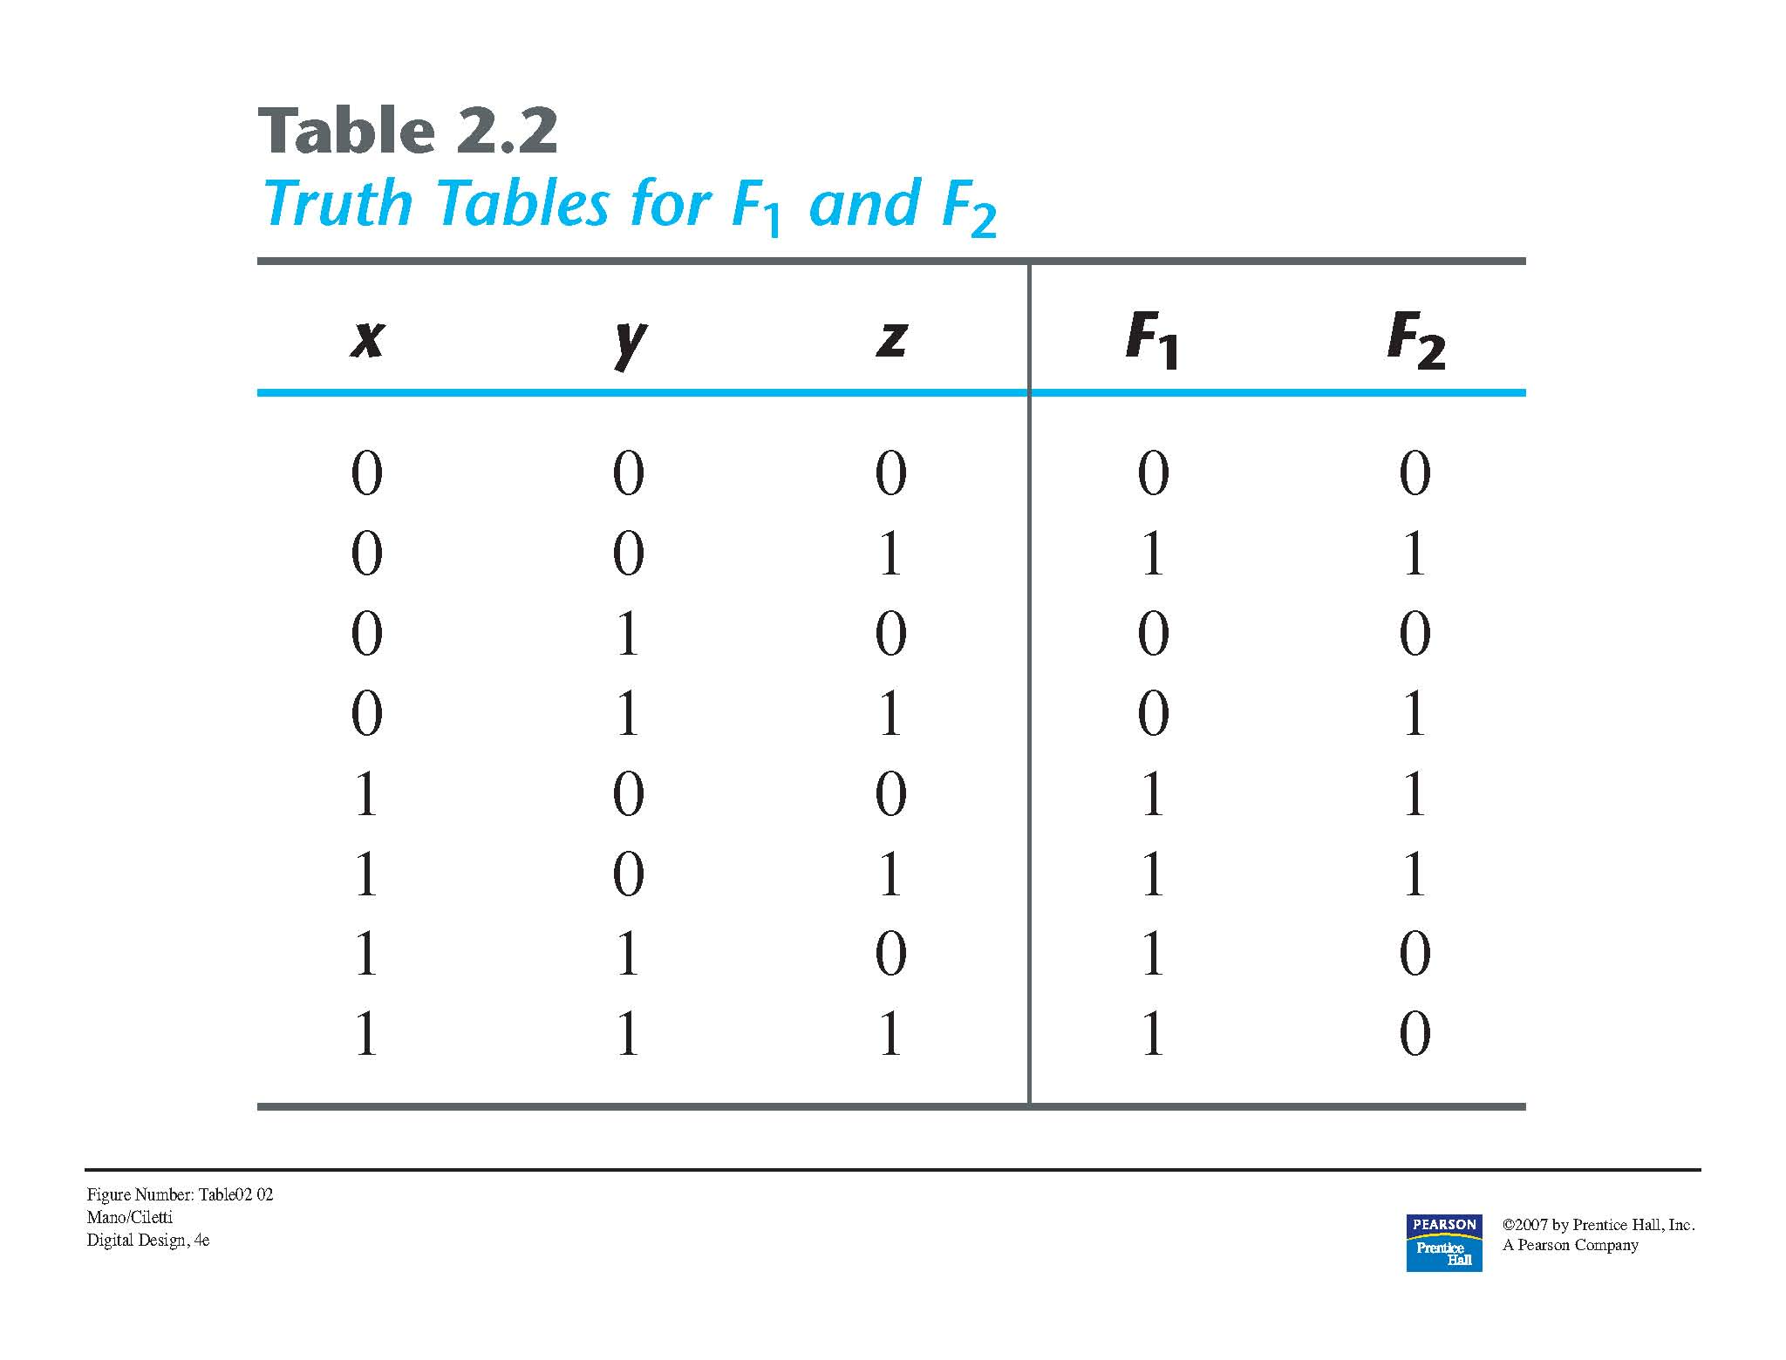
Boolean functions

Slide 22
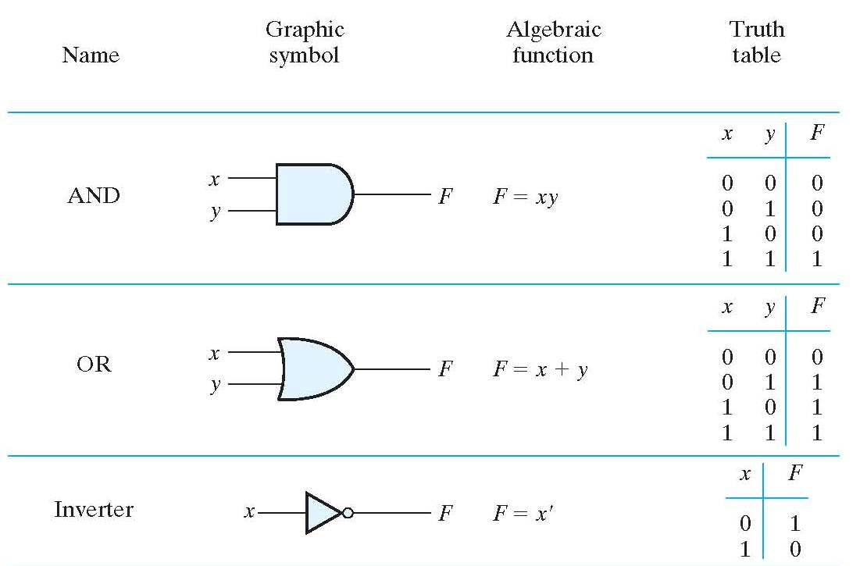
Boolean Functions

Slide 23
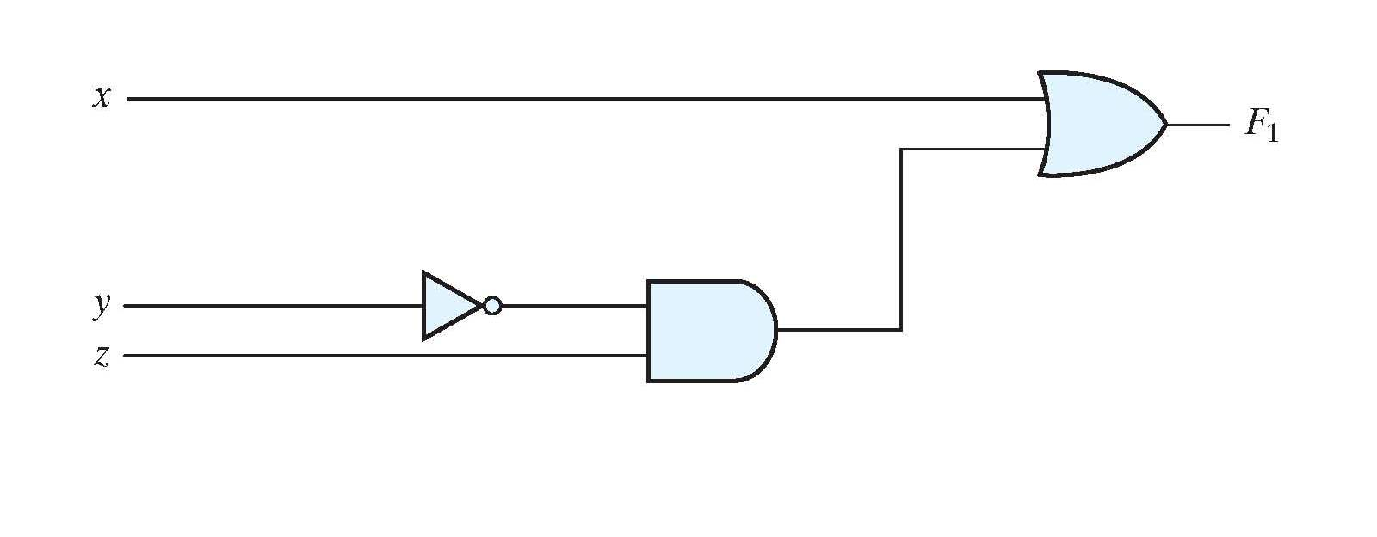
Boolean functions
Transform the algebraic equation of F₁ to a circuit diagram using logic gates

Slide 24
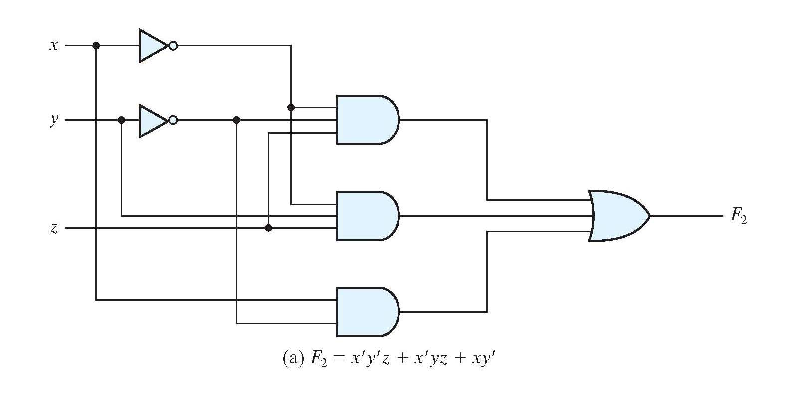
Boolean functions
Transform the algebraic equation of F₂ to a circuit diagram using logic gates

Slide 25


Boolean functions
Algebraic manipulation can yield smaller (simpler) expressions, and a smaller implementation (lower cost)

Slide 26
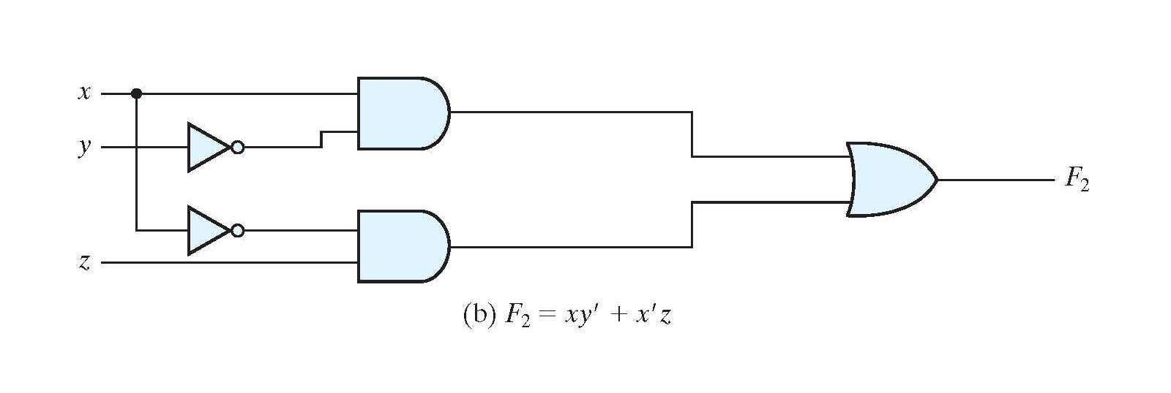
Boolean functions

Slide 27
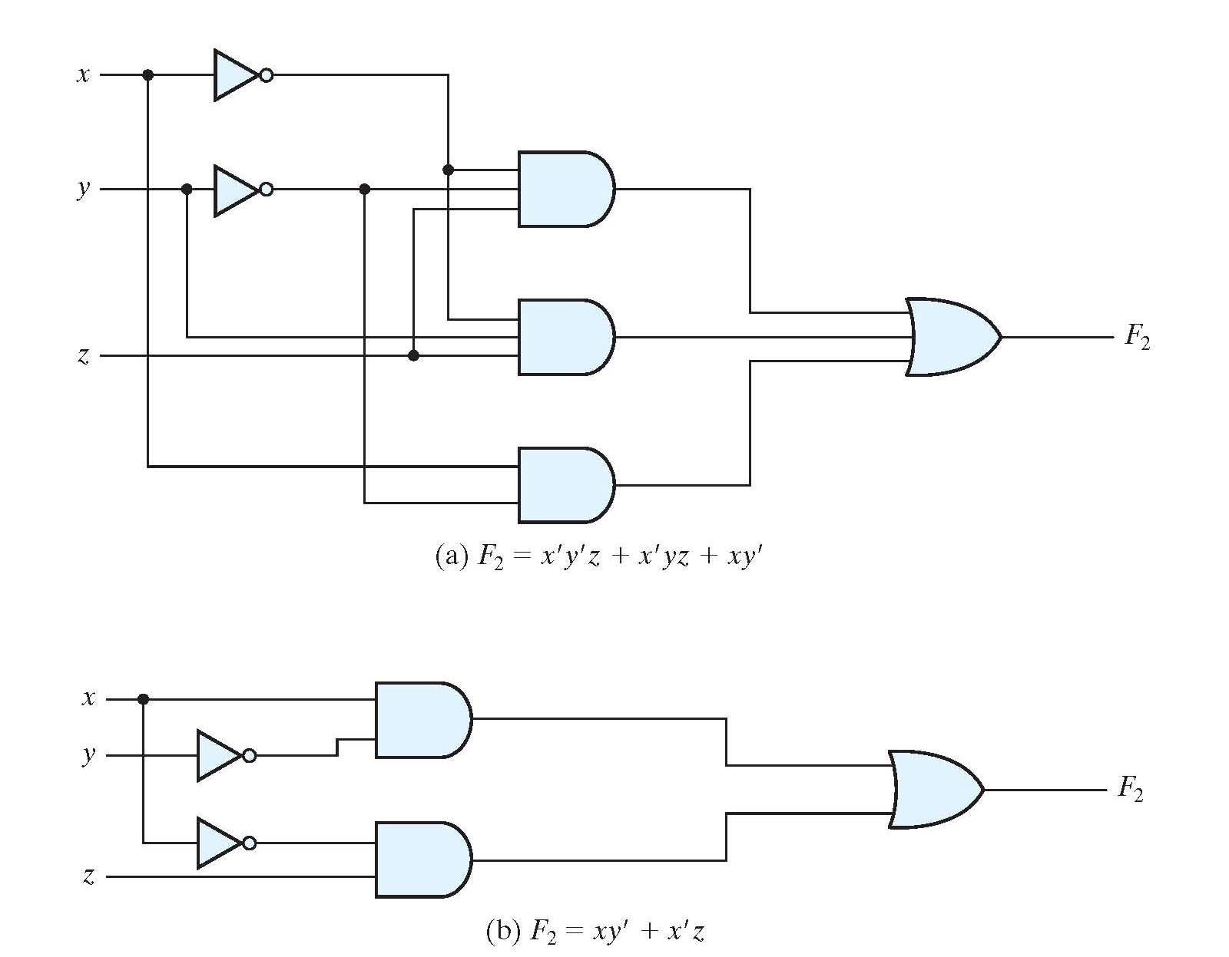
Boolean functions
Compare the two implementations

Slide 28
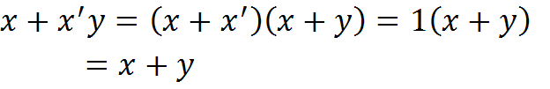
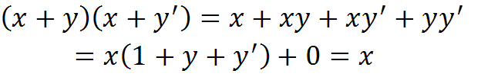
Algebraic manipulation
Example 1
Example 2
Example 3

Slide 29



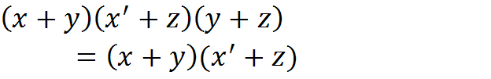
Algebraic manipulation
Example 4
Example 5
By duality of Example 4

Slide 30
Complement of a function
Generalization of DeMorgan’s theorems

Slide 31








Complement of a function
Find the complement of the following functions

Slide 32






Complement of a function
Find the complement of the following functions by taking their duals and complementing each literal
The dual
Complement each literal
The dual
Complement each literal

Slide 33
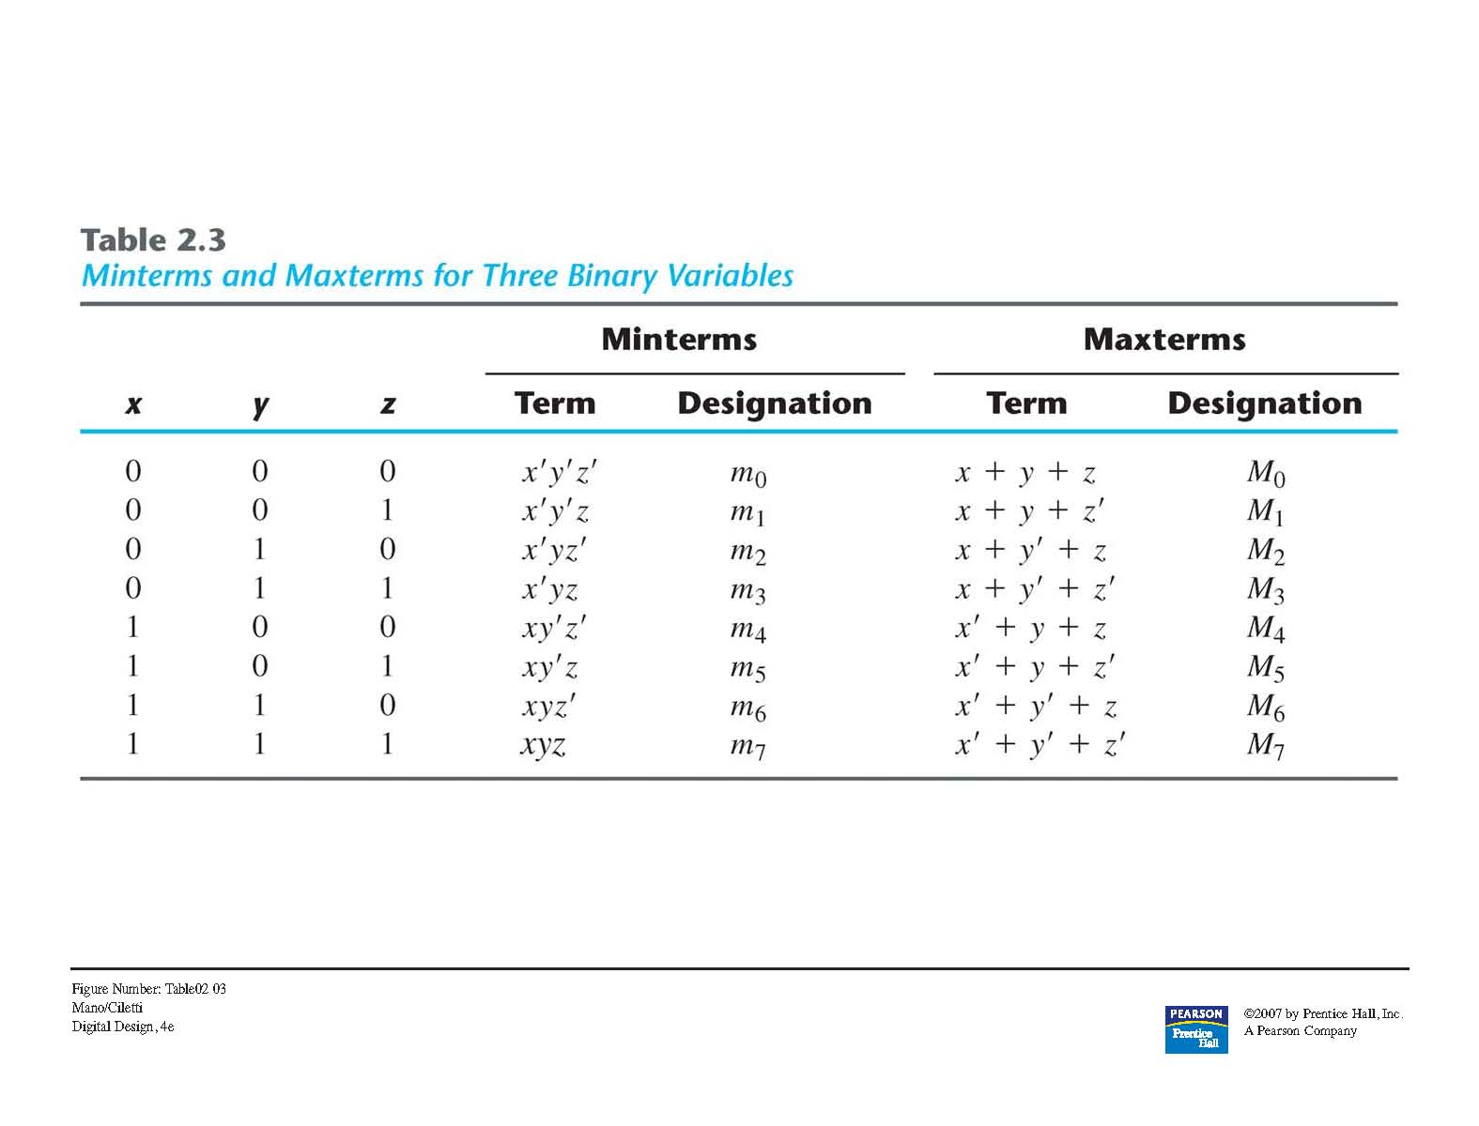
Canonical and Standard Form

Slide 34
Minterms and maxterms
Minterm or standard product: product of variables or their complement (all) in Boolean function.
If n variables 2^{n} possible combinations.
Obtained from truth table of function

Slide 35
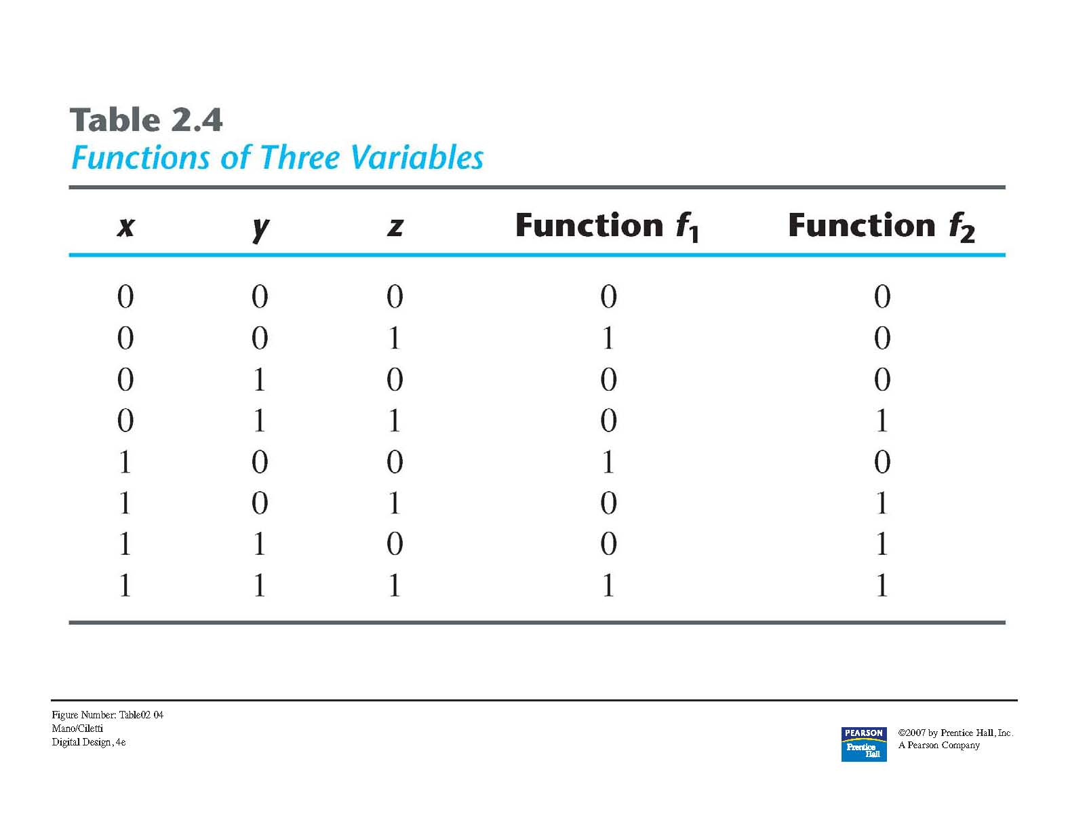
Minterms and maxterms
Example of two Boolean functions on truth table

Slide 36




Minterms
From truth table

Slide 37
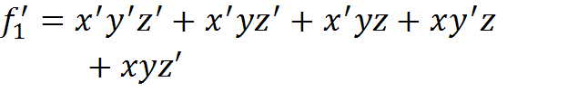
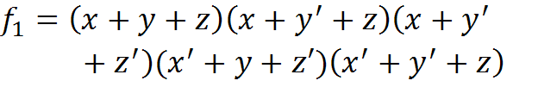

Maxterms
Complementing function and applying DeMorgan’s Theorem
Complement applying DeMorgan’s

Slide 38
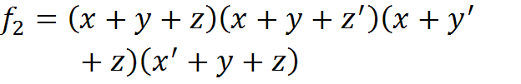

Maxterms
Complementing function and applying DeMorgan’s Theorem
Complement applying DeMorgan’s

Slide 39
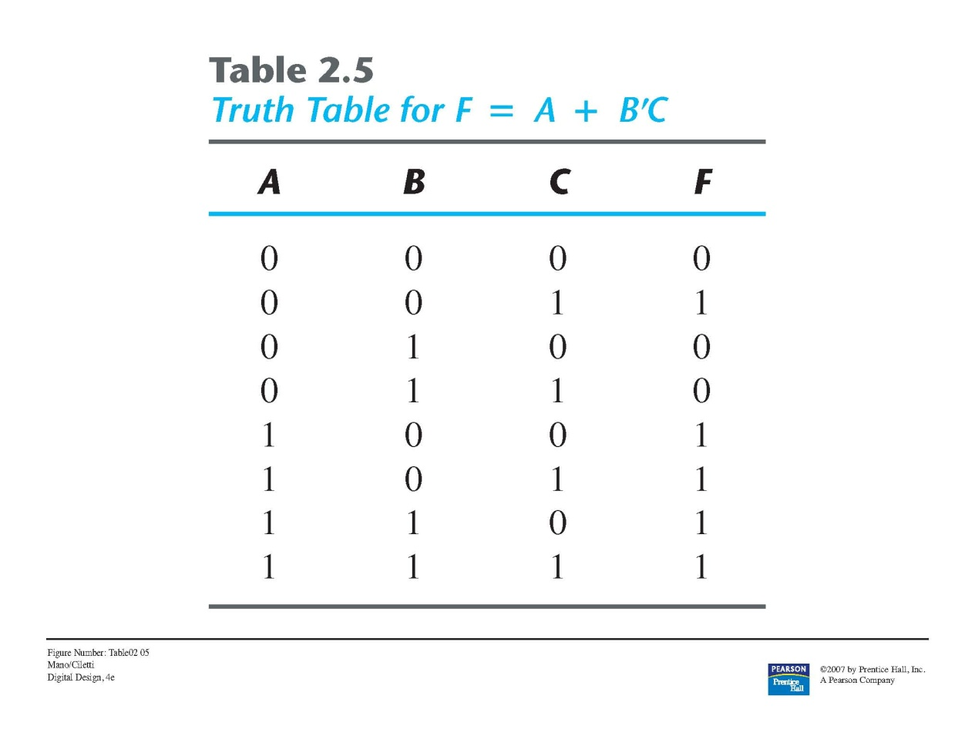



Example 2.4

Slide 40






Conversion between canonical forms
Complement function
Complement using DeMorgan’s Theorem

Slide 41
Conversion between canonical forms
Interchange the symbols Σ and Π
List the numbers missing from the original form (remember there are 2^{n} minterms of maxterms , where n is the number of binary variables in the function)

Slide 42
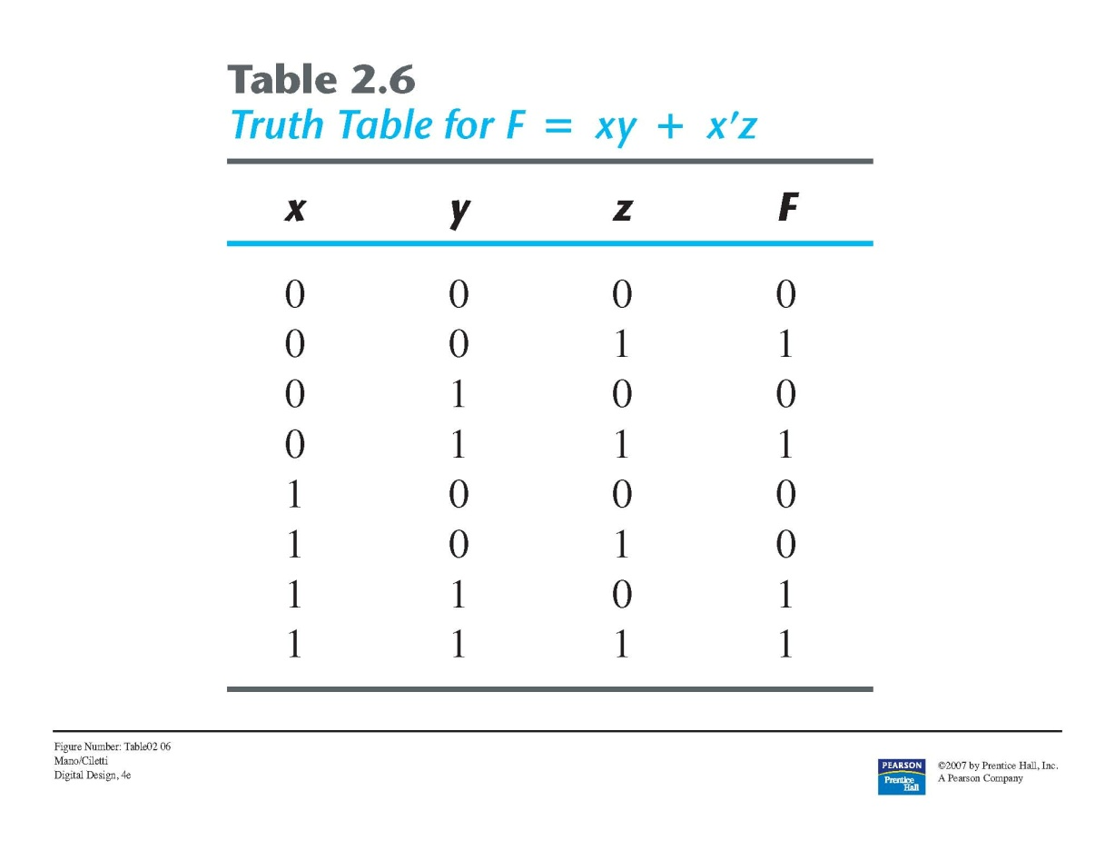



Conversion between canonical forms

Slide 43
Standard Forms
Sum of products (not canonical necessarily)
Product of sums (not canonical necessarily)

Slide 44
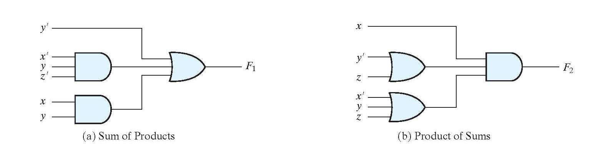


Standard forms
Obtain from diagram the standard forms

Slide 45
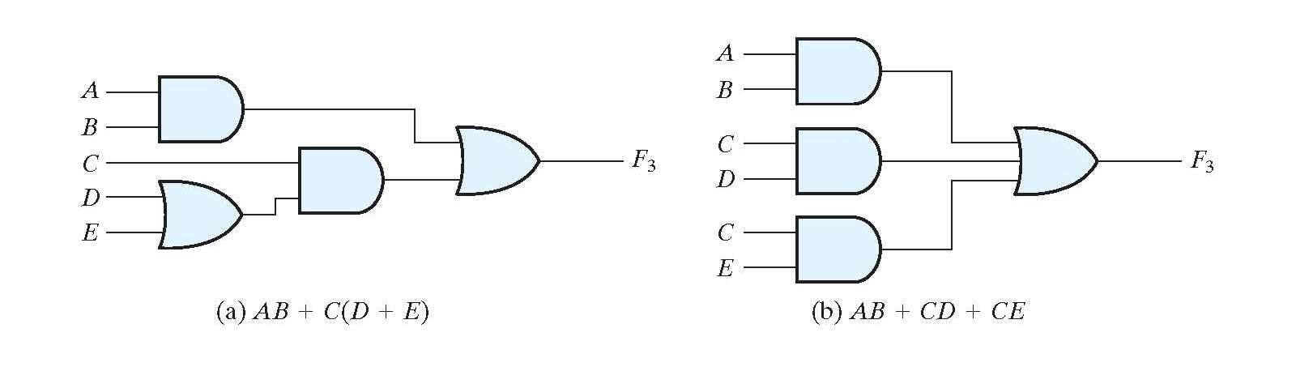
Standard forms
Three- and two-level implementations
Use distributive law to remove parenthesis

Slide 46
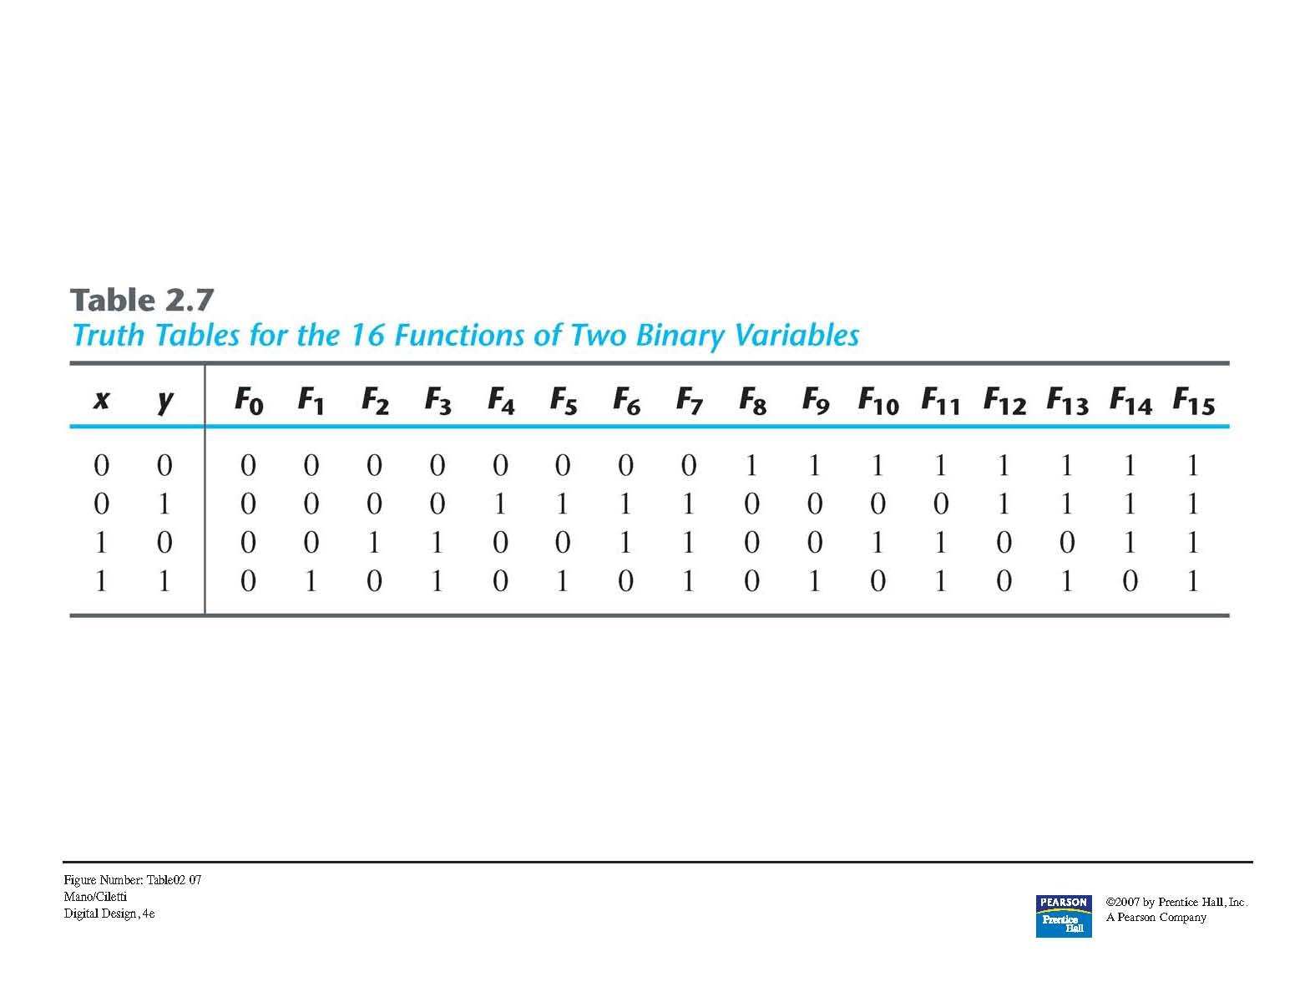
Other logic operations

Slide 47
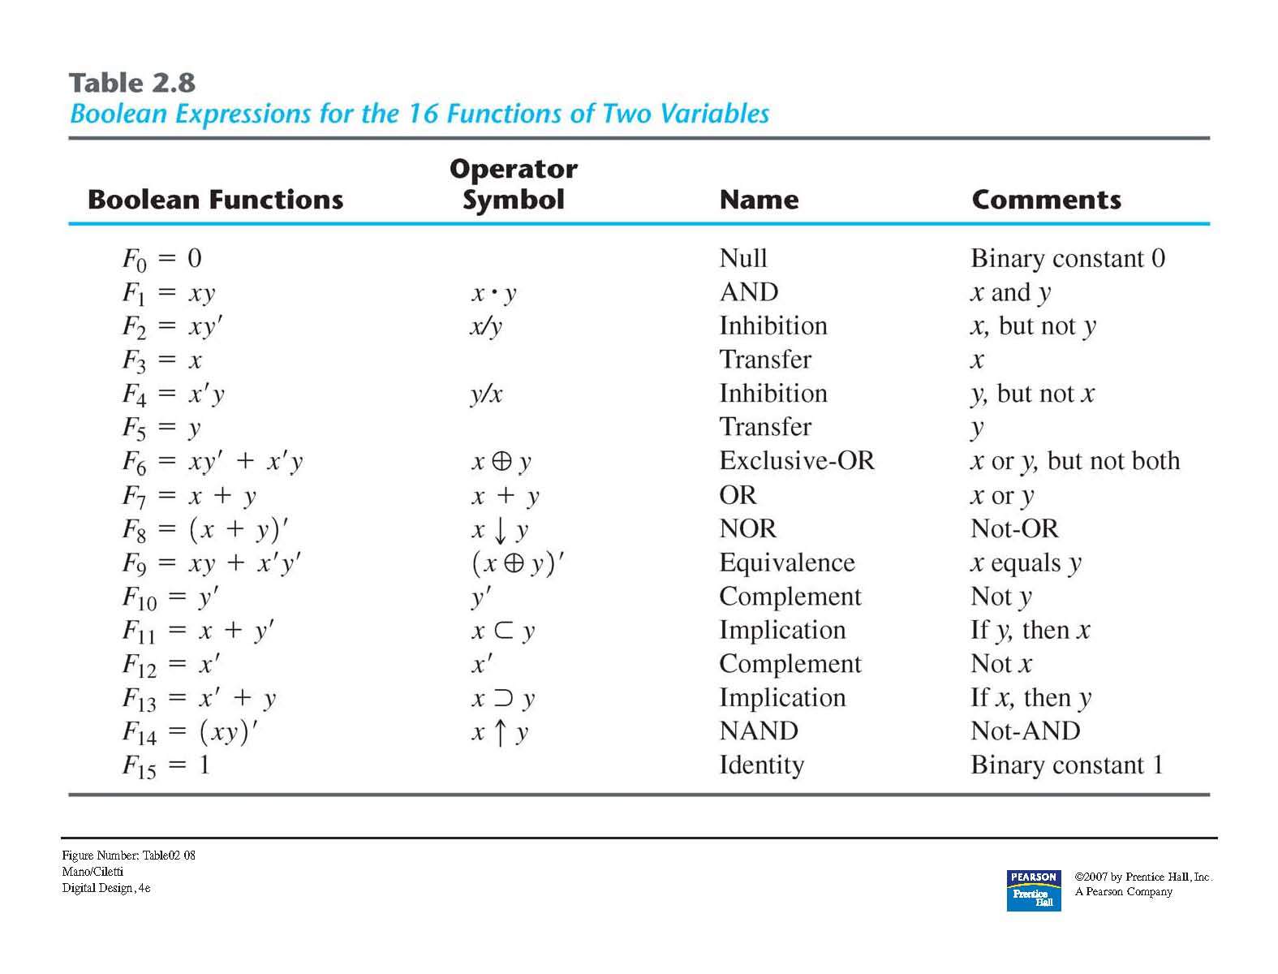
Other Logic Operations

Slide 48
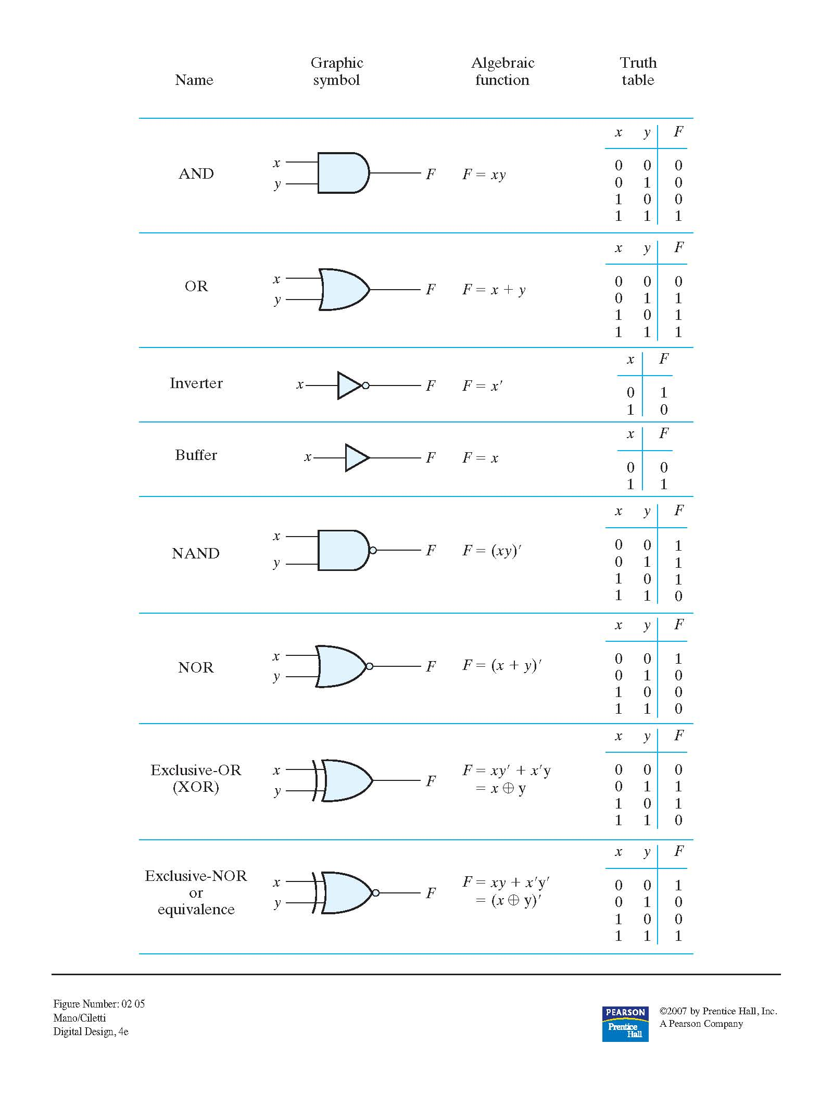
Digital Logic Gates

Slide 49
Extension to multiple inputs
NOT: only one input
OR: commutative and associative, thus no problem
AND: commutative and associative, thus no problem
NAND: commutative but not associative!
NOR: commutative but not associative!

Slide 50


Extension to multiple inputs
NOR gate
NAND gate

Slide 51
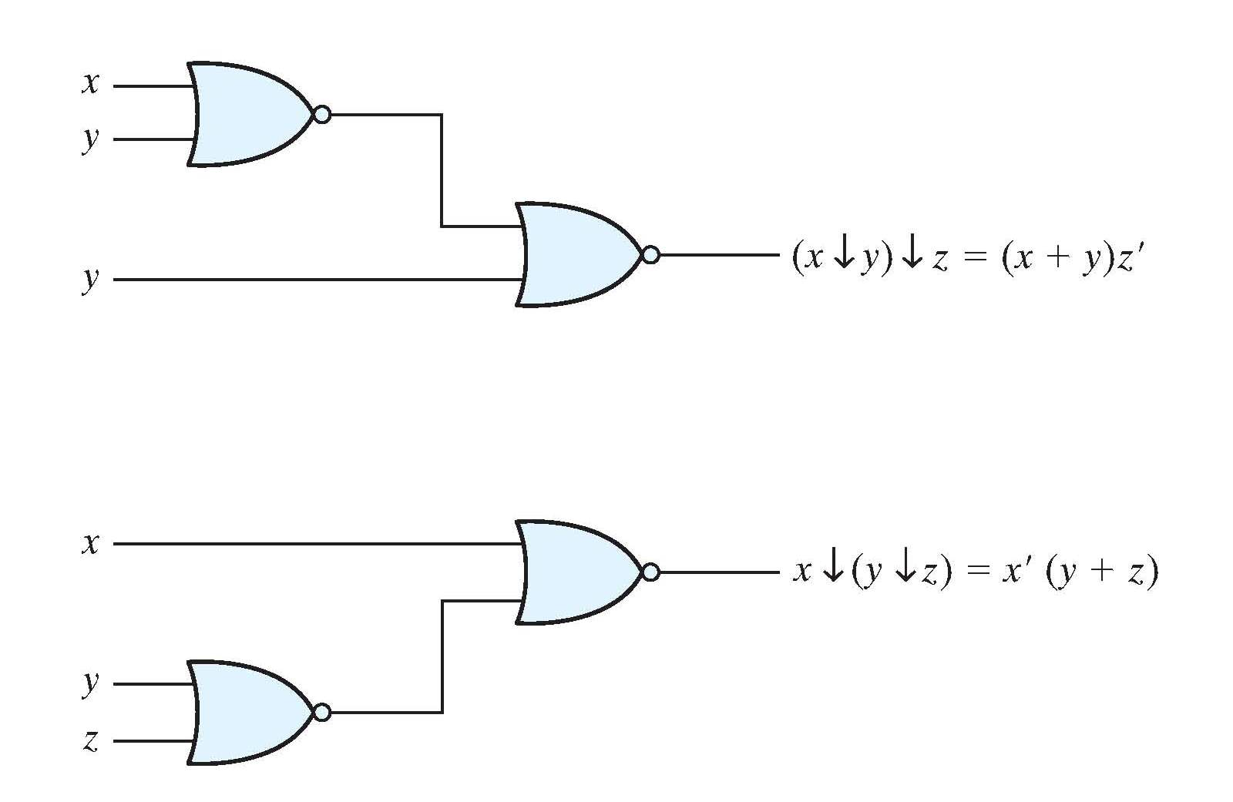
Extension to multiple inputs

Slide 52
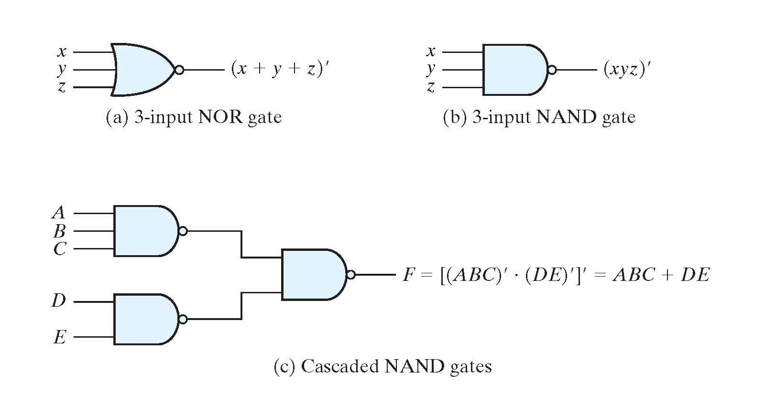
Extension to multiple inputs

Slide 53
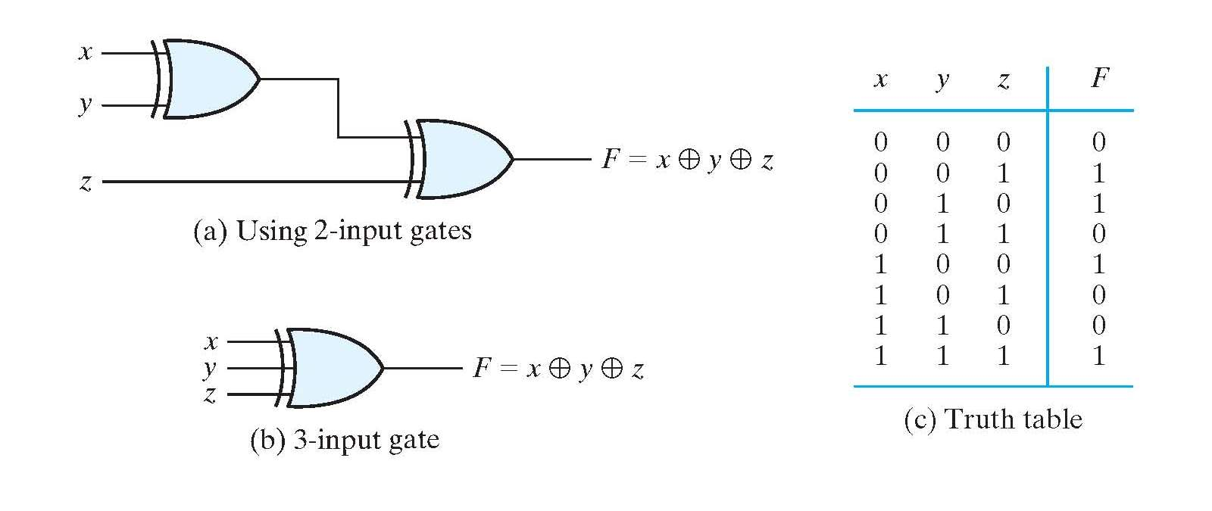
Extension to multiple inputs

Slide 54
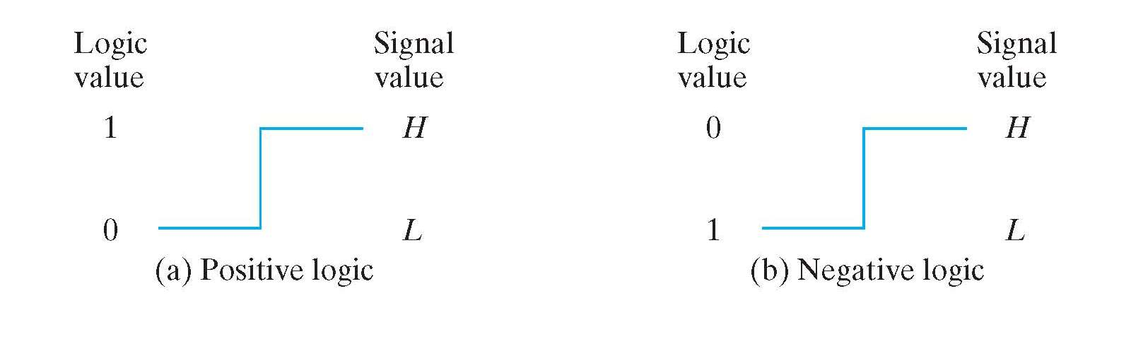
Positive and Negative Logic

Slide 55
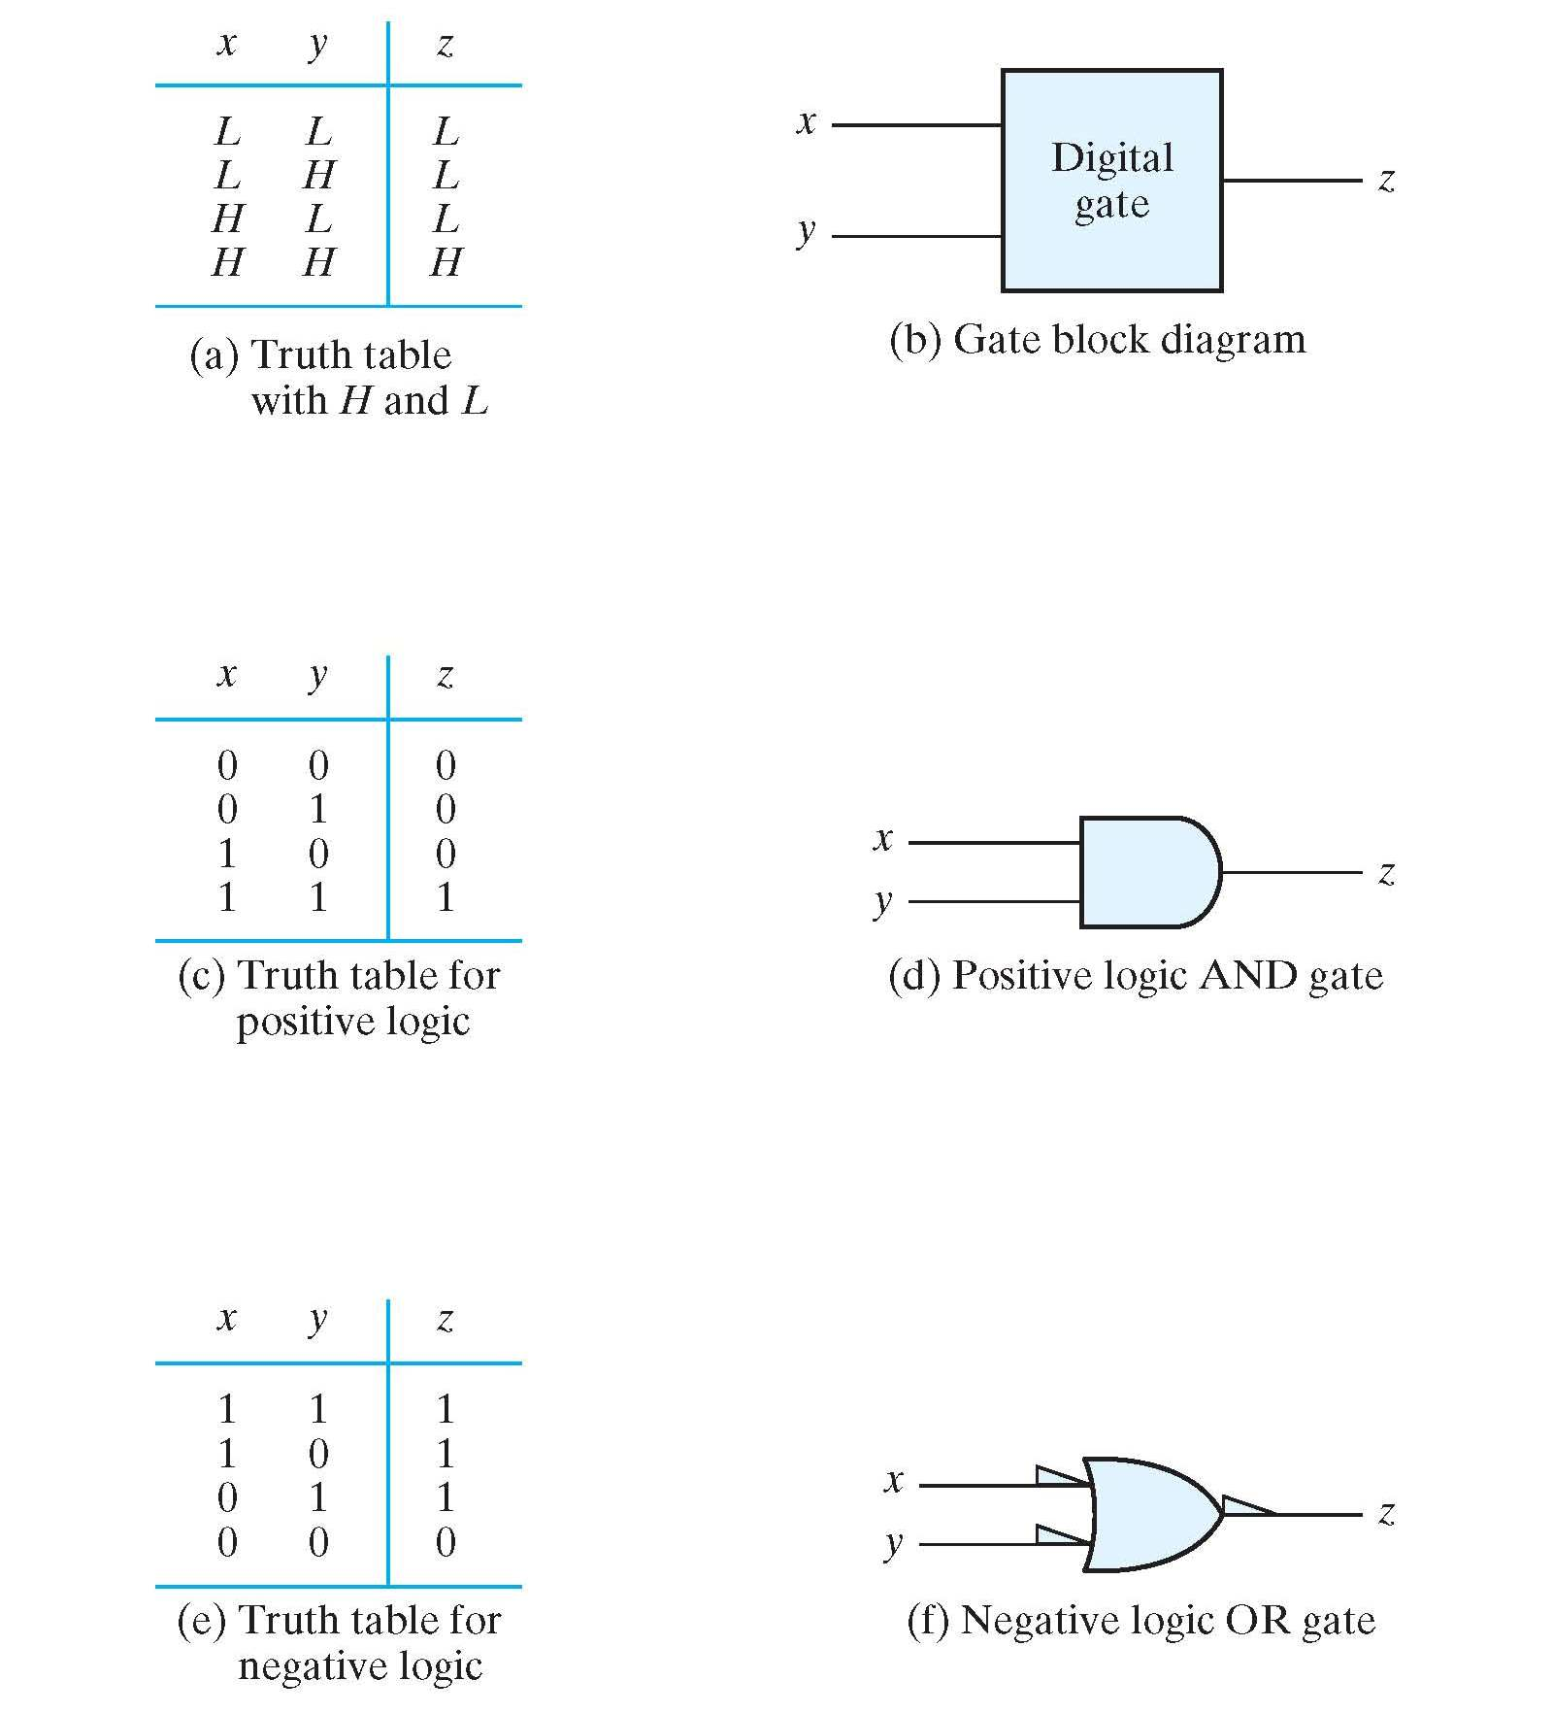
Positive and Negative Logic

Slide 56
Integrated Circuits
Small-Scale Integration (SSI): fewer than 10 gates per chip
Medium-Scale Integration (MSI): 10 to 1000 gates per chip
Large-Scale Integration (LSI): Several thousands of gates per chip
Very Large-Scale Integrations (VLSI): hundreds of thousands of gates per chip

Slide 57
Digital logic families
TTL: Transistor-Transistor Logic
ECL: Emitter-Coupled Logic
MOS: Metal-Oxide Semiconductor
CMOS: Complementary Metal-Oxide Semiconductor

Slide 58
Computer-Aided Design
Hardware Description Language (HDL)
  Tools to simulate, verify functionality, and automatically and optimally synthesize the logic described in HDL
IEEE approved HDL standards:
  Verilog HDL
  VHDL

Slide 59
Homework Assignment
2.1
2.2
2.5
2.9
2.10
2.12
2.14
2.18
2.20
2.28

Slide 60
Homework Assignment (Bonus)
Obtain the datasheet for the CD4001 CMOS Quad two-input NOR Gates and explain in your own words the data in the Static Electrical Characteristics, Recommended Operating Conditions and the Dynamic Electrical Characteristics
You can work in groups and turn your bonus assignment in one per group, but to obtain the bonus (5 points for your first test) you must answer one question about the datasheet in your test.

