Slide 1
The following material is the result of a curriculum development effort to provide a set of courses to support bioinformatics efforts involving students from the biological sciences, computer science, and mathematics departments. They have been developed as a part of the NIH funded project “Assisting Bioinformatics Efforts at Minority Schools” (2T36 GM008789). The people involved with the curriculum development effort include:
Dr. Hugh B. Nicholas, Dr. Troy Wymore, Mr. Alexander Ropelewski and Dr. David Deerfield II, National Resource for Biomedical Supercomputing, Pittsburgh Supercomputing Center, Carnegie Mellon University.
Dr. Ricardo Gonzalez-Mendez, University of Puerto Rico Medical Sciences Campus.
Dr. Alade Tokuta, North Carolina Central University.
Dr. Jaime Seguel and Dr. Bienvenido Velez, University of Puerto Rico at Mayaguez.
Dr. Satish Bhalla, Johnson C. Smith University.
Unless otherwise specified, all the information contained within is Copyrighted © by Carnegie Mellon University. Permission is granted for use, modify, and reproduce these materials for teaching purposes.

Slide 2
This material is targeted towards students with a general background in Biology. It was developed to introduce biology students to the computational mathematical and biological issues surrounding bioinformatics. This specific lesson deals with the following fundamental topics:
  Computing for biologists
  Computer Science track
  This material has been developed by:
  Dr. Hugh B. Nicholas, Jr.
  National Center for Biomedical Supercomputing
  Pittsburgh Supercomputing Center
  Carnegie Mellon University

Slide 3
Bioinformatics Data Management
Lecture 2
Unstructured Data Repositories
  Bienvenido Vélez
  UPR Mayaguez
Reference: BioInformatics for Dummies

Slide 4
Unstructured Data Repositories: Outline
Introduction and Examples
Query Models
Implementation Issues
References

Slide 5
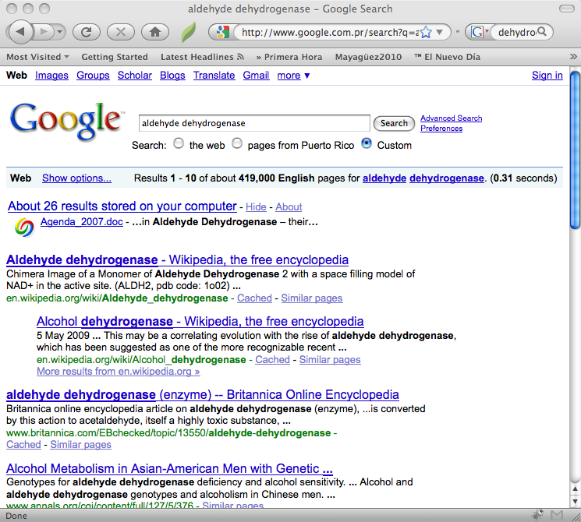
Introduction and Examples
Basic Paradigm
Find all documents
containing some terms
and rank them according
to expected relevance

Slide 6
Characteristics of Unstructured Databases
Contain a collection of generic “documents” (many formats)
Each document has an associated set of terms
Queries also consists of sets of terms
Documents are ranked according to their similarity to the query
There are lots of ways of measuring query/document similarity

Slide 7
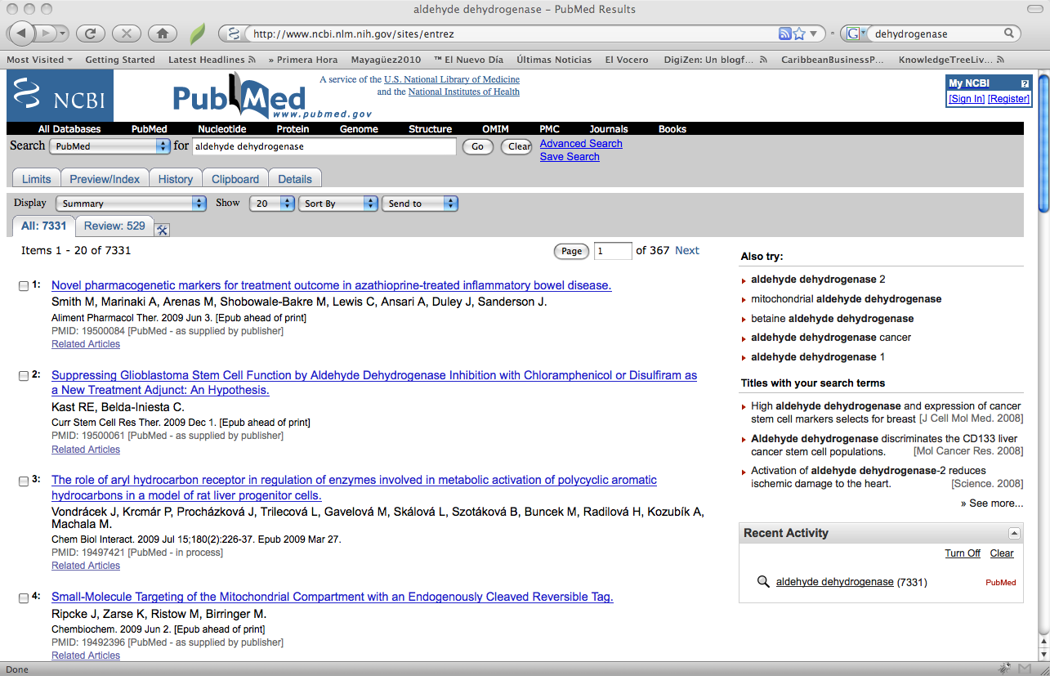
PubMed a Domain Specific Unstructured Database

Slide 8
Unstructured Data Repositories: Outline
Introduction and Examples
Query Models
Implementation Issues
References

Slide 9
Query Models Subtopics
Boolean Query Model
Vector Space Query Model
Practical Query Models: The Case of Google
Notes:
Extended Boolean
Query is a Boolean combination of weighted terms
Hybrid
Some terms have weights, others must or must not appear in document
Context specific
Query specifies a section of the document where terms should appear

Slide 10
The Boolean Query Model: Definition
A Boolean query consists of one of the following:
  A single term
  The negation (NOT) of a single Boolean query
  A conjunction (AND) of two Boolean queries
  A disjunction (OR) of two Boolean queries
Examples of Boolean queries
aldehyde | Single term
(or aldehyde dehydrogenase) | Disjunction
(and aldehyde dehydrogenase) | Conjunction
(and (and aldehyde dehydrogenase) (not isocitrate)) | Compound

Slide 11
The Boolean Query Model: Definition
Query consists of: | Document Matches When:
t | Document contains at least one occurrence of term t
(not q) | Document does not match query q
(and q1 q2) | Document matches boths queries q1 and q2
(or q1 q2) | Document matches either query q1 or q2
A strictly Boolean query model does not include a
mechanism for ranking matching documents

Slide 12
Computing Boolean Queries
selected
All documents
Not selected
and Q1, Q2

Slide 13
Computing Boolean Queries
selected
All documents
Not selected
or Q1, Q2

Slide 14
Computing Boolean Queries
selected
All documents
Not selected
SLIDE HIDDEN
or Q1, Q2

Slide 15
Computing Boolean Queries
selected
All documents
Not selected
Q1
not Q1

Slide 16
What Makes a Good Boolean Query?
It should match all “relevant” documents
It should not match any “ non-relevant” documents
Question 1: When is a document relevant?
  Answer: When it fulfils our information need
Question 2: Are all matching documents relevant?
  Answer: Not really, although we design the query with this goal in mind.

Slide 17
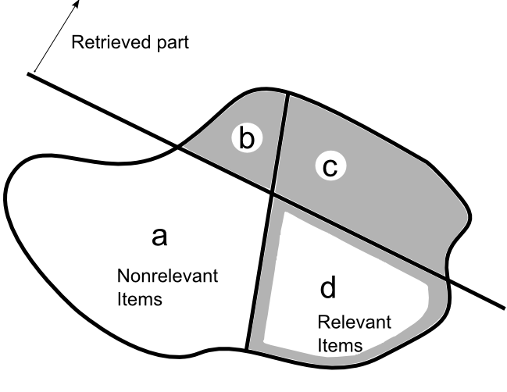
Measuring Boolean Query effectiveness

Slide 18
Measuring Boolean Query Effectiveness
Precision
Recall
Question: Can we really measure the effectiveness of any query? Why?
Formula 9.1 and 9.2
From: Gerald Salton, Automatic Text Processing

Slide 19
Measuring Boolean Query Effectiveness
Total relevant retrieved = 5
Total retrieved = 8
Total relevant = 20 (assumed)
Precision = 5/8 = 52.5%
Recall = 5/20 = 25%
Not specific order
Retrieval documents
(result set)
Notes:
Pag 354, poner q orden es inmaterial
Poner algunos rojos

Slide 20
Query Models Subtopics
Boolean Query Model
Vector Space Query Model
Practical Query Models: The Case of Google
Notes:
Extended Boolean
Query is a Boolean combination of weighted terms
Hybrid
Some terms have weights, others must or must not appear in document
Context specific
Query specifies a section of the document where terms should appear

Slide 21
The Vector Space Query Model: Definition
A Vector Space query consists of a list of terms with corresponding numeric weights
Usually implicit default weights are assigned when needed
Examples of vector space queries
  aldehyde
  (aldehyde:10 dehydrogenase:25)
  (isocitrate:1 aldehyde:3 dehydrogenase:10)
SLIDE HIDDEN
Notes:
Poner tablita de los booleans

Slide 22
The Vector Space Query Model: Definition
A Vector Space query consists of a list of terms with corresponding numeric weights
Usually implicit default weights are assigned when needed
Query consists of: | Document Matches When:
aldehyde | Document contains term aldehyde
(aldehyde:10 dehydrogenase:25) | Document that contains terms aldehyde or dehydrogenase. Documents with dehydrogenase ranked higher.
(isocitrate:-3 aldehyde:3 dehydrogenase:10) | Document may contains terms aldehyde, dehydrogenase or isocitrate. Documents with dehydrogenase ranked higher.
A vector query model can support multiple mechanisms for ranking
matching documents according to expected similarity

Slide 23
Measuring Vector Space Query Effectiveness
Total relevant retrieved = 4
Total retrieved = 5
Total relevant = 10
Precision = 4/5 = 80%
Recall = 4/10 = 40%
Documents analyzed
Retrieval documents
(result set)
Documents D6-D8 not analyzed yet

Slide 24
Measuring Vector Space Query Effectiveness
Total relevant retrieved = 5
Total retrieved = 8
Total relevant = 10 (assumed)
Precision = 5/8 = 62.5%
Recall = 4/10 = 50%
Retrieval documents
(result set)

Slide 25
In Vector Space Query Model Precision and Recall constitute a tradeoff

Slide 26
Examples of Similarity Measures
Similarity Measure sim(X,Y) | Evaluation for Binary Term Vectors | Evaluation for Weighted Term Vectors
Inner product
Dice coefficient
Cosine coefficient
Jaccard coefficient
Legend:
X=(x1,x2,…,xt)
= number of terms in X
=number of terms appearing jointly in X and Y
SLIDE HIDDEN
Table from:
Gerald Salton,
Automatic Text Processing
Page 318

Slide 27
Examples of Similarity Measures
Similarity Measure sim(X,Y) | Evaluation for Binary Term Vectors | Evaluation for Weighted Term Vectors
Inner product
Dice coefficient
Cosine coefficient
Jaccard coefficient
Legend:
X=(x1,x2,…,xt)
= number of terms in X
=number of terms appearing jointly in X and Y
Table from:
Gerald Salton,
Automatic Text Processing
Page 318

Slide 28
Diced coefficient:
A Normalized Similarity Measure
t2
d1
0 ≤ cos α ≤ 1
cos α = 1
2D example
d2
t1

Slide 29
Query Models Subtopics
Boolean Query Model
Vector Space Query Model
Practical Query Models: The Case of Google
Notes:
Extended Boolean
Query is a Boolean combination of weighted terms
Hybrid
Some terms have weights, others must or must not appear in document
Context specific
Query specifies a section of the document where terms should appear

Slide 30
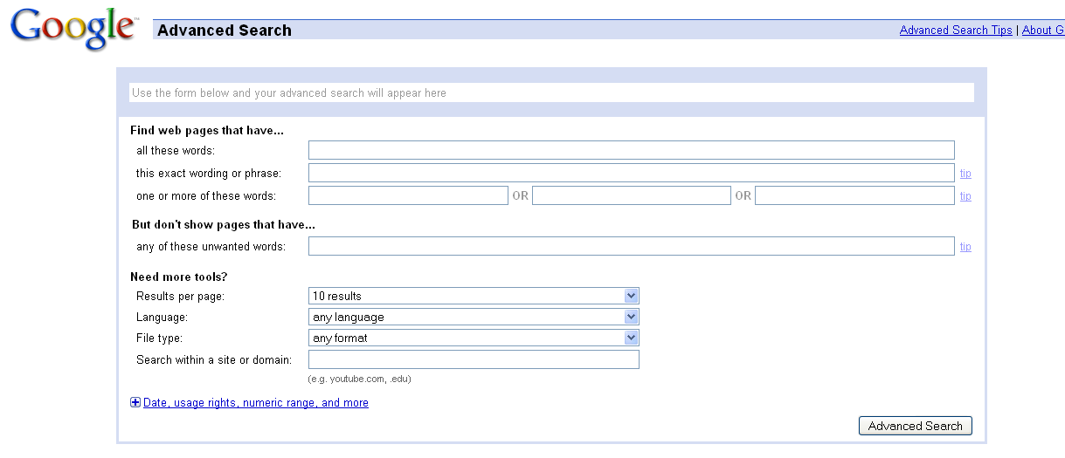
Google’s Query Model
conjunction
phrases
disjunction

Slide 31
Google’s Query Model
Operator | Description
“<phrase>” | Phrase search. By putting double quotes around a list of words, Google considers the exact words in that exact order without any change.
site: | Search within a specific website. Specify that your search results must come from a specific website.
- | Terms you want to exclude
* | Wildcard. Google treats the star as a placeholder for any unknown term(s) and then find the best matches.
+ | Search term exactly as it appears
OR | Disjunction of terms
Most practical query models are hybrid!

Slide 32

Sample Advance Google’s Query #1
Simple and common Google search query
  aldehyde dehydrogenase

Slide 33
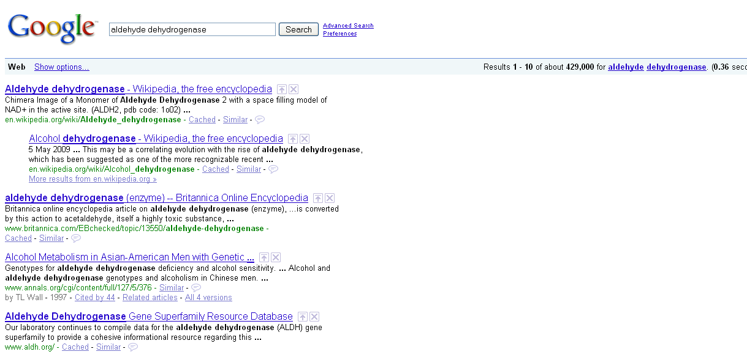
Results of Google Query #1

Slide 34
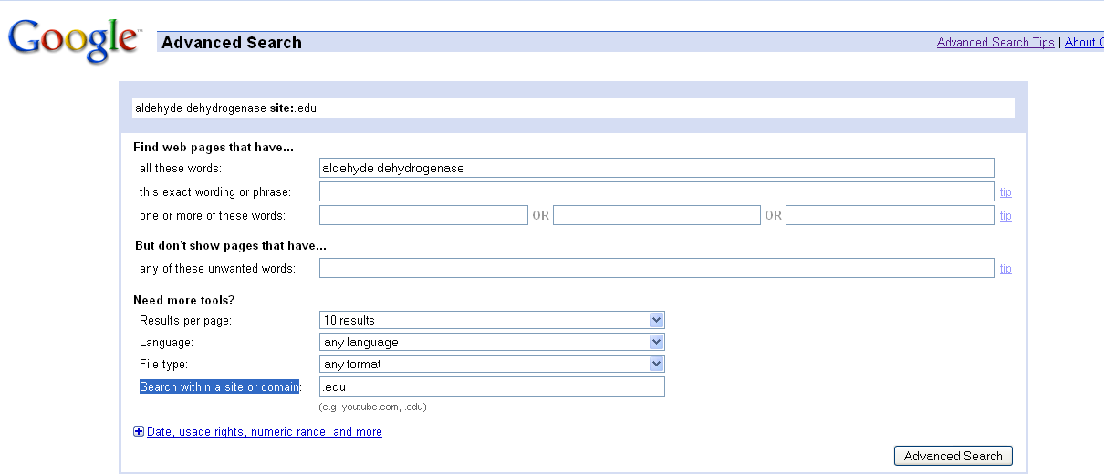
Sample Advance Google’s Query #2
Google search query within a site or domain
  All educational sites
    site:.edu aldehyde dehydrogenase

Slide 35
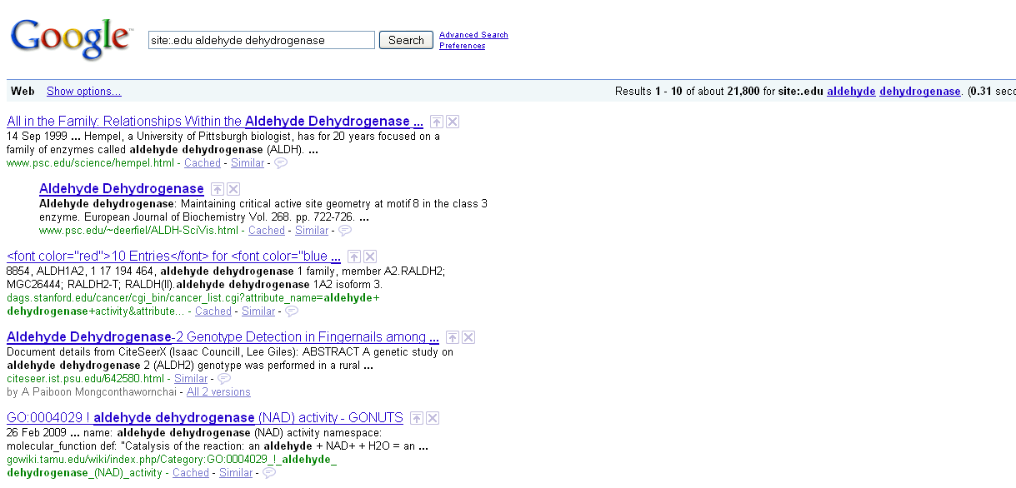
Results of Google Query #2

Slide 36
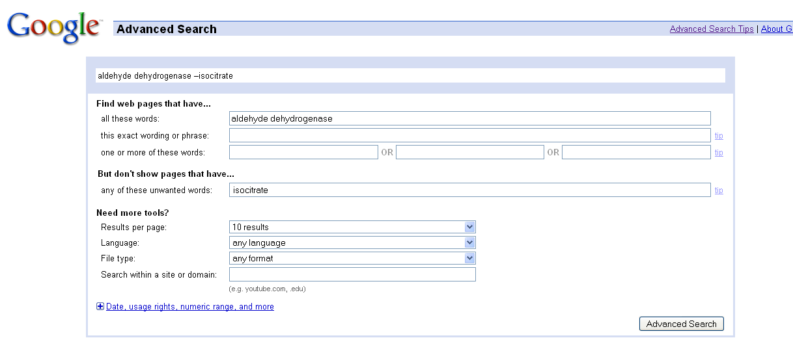
Sample Advance Google’s Query #3
Google search query of the phrase aldehyde dehydrogenase, but the results not contains the word alcohol
    aldehyde dehydrogenase –isocitrate

Slide 37
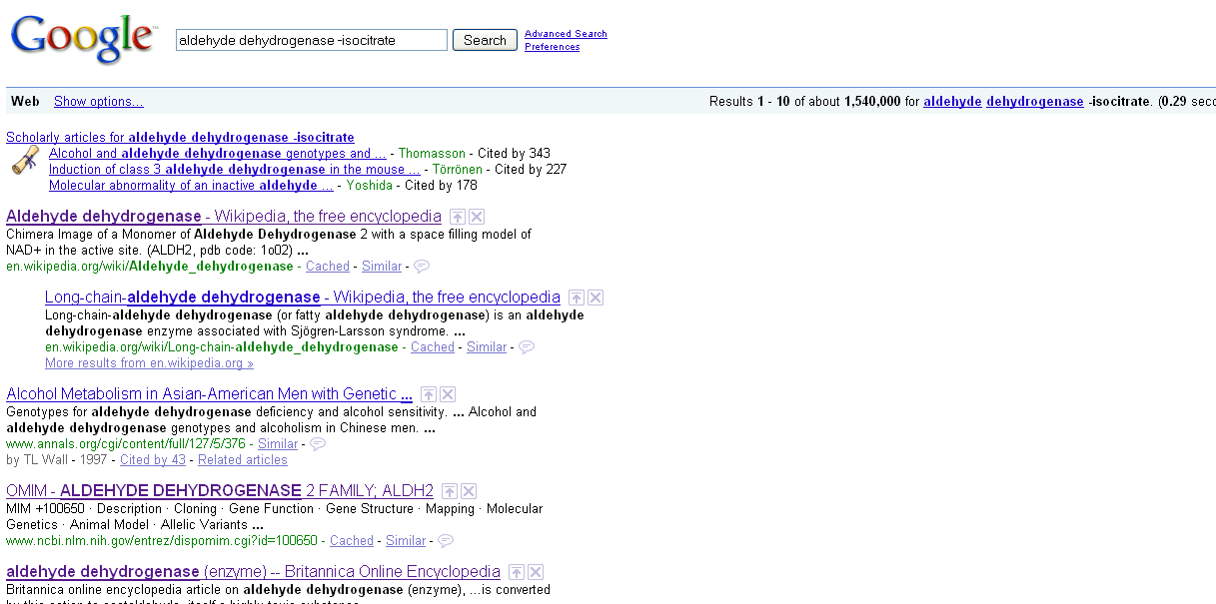
Results of Google Query #3

Slide 38
Unstructured Data Repositories: Outline
Introduction and Examples
Query Models
Implementation Issues
References

Slide 39
Architecture of an Information Retrieval System
Indexing
Query Procesing
Documents
Query
Index
Parse
Document Surrogates
Query Surrogates
Invert
Process
Inverted File
Results
Offline
Online

Slide 40
Implementation Issues Subtopics
The Inverted File Data Structure
Query Processing Using Inverted Files
Inverted File Generation Algorithm
Inverted file management for scalability
Automatic Indexing

Slide 41
The Inverted File
T1
T2
T1
T3
SLIDE HIDDEN

Slide 42
The Inverted File
D1
D2
D1
D3
SLIDE HIDDEN

Slide 43
The Inverted File Data Structure
T1
T2
T1
Terms appearing in each document
T3
inverted
D1
D2
D1
Documents where each term appears
D3
Ti’s = terms
Di’s = documents

Slide 44
Implementation Issues Subtopics
The Inverted File Data Structure
Query Processing Using Inverted Files
Inverted File Generation Algorithm
Inverted file management for scalability
Automatic Indexing

Slide 45
An Example Document Set
assumed
Example of Document 1
Example of Document 2
Example of Document 3
Example of Document 4
Notes:
1 y 3 relevantes (azul), los otros rojos (pintarlos y ponerlos en el shape de los otros)

Slide 46
The Inverted File Data Structure for Example Document Set
Document 1
Tf:1
Document 2
Tf:1
Document 1
Tf:1
Document 2
Tf:1
Document 3
Tf:2
Document 2
Tf:1
Document 4
Tf:1
Documents
Tf = term frequency
Terms appearing in each document

Slide 47
Inverted File
Example of boolean queries
  (and
  (and aldehyde dehydrogenase)
  (not isocitrate))
  (or aldehyde dehydrogenase)
  (and aldehyde dehydrogenase)
En este slide no se pq cambio los valores de los total relevant
Total relevant retrieved = 2
Total retrieved = 3
Total relevant = 10
Total relevant retrieved = 1
Total retrieved = 2
Total relevant = 10
Total relevant retrieved = 1
Total retrieved = 1
Total relevant = 10
Precision = 2/3 = 66.7%
Recall = 3/10 = 20%
Precision = 1/2 = 50%
Recall = 1/10 = 10%
Precision = 1/1 = 100%
Recall = 1/10 = 10%
Notes:
= q el anterior, arreglar las formulas, ponerlas exactamente = q en la tabla

Slide 48
The Inverted File
Example of vector space queries
(isocitrate:-3 aldehyde:3 dehydrogenase:10)
(aldehyde:10 dehydrogenase:25)
aldehyde
Verif orden este correcto
Escribir las similaridades
SLIDE HIDDEN
Sim(Q,D)=
Sim(Q,D)=
Sim(Q,D)=
Notes:
Poner query = q en tabla

Slide 49
The Inverted File
Inner product similarity
(isocitrate:-3 aldehyde:3 dehydrogenase:10)
Query
Document 1
aldehyde
dehydrogenase
isocitrate

Slide 50
The Inverted File
Dice vector similarity
(isocitrate:-3 aldehyde:3 dehydrogenase:10)
Query
Document 1
aldehyde
dehydrogenase
isocitrate

Slide 51
The Inverted File
Cosine similarity
(isocitrate:-3 aldehyde:3 dehydrogenase:10)
Query
Document 1
aldehyde
dehydrogenase
isocitrate

Slide 52
The Inverted File
Jaccard similarity :
(isocitrate:-3 aldehyde:3 dehydrogenase:10)
Query
Document 1
aldehyde
dehydrogenase
isocitrate

Slide 53
The Inverted File
Inner product similarity
(isocitrate:-3 aldehyde:3 dehydrogenase:10)
Query
Document 2
aldehyde
dehydrogenase
isocitrate

Slide 54
The Inverted File
Dice vector similarity
(isocitrate:-3 aldehyde:3 dehydrogenase:10)
Query
Document 2
aldehyde
dehydrogenase
isocitrate
Notes:
Poner query = q en tabla

Slide 55
The Inverted File
Cosine similarity
(isocitrate:-3 aldehyde:3 dehydrogenase:10)
Query
Document 2
aldehyde
dehydrogenase
isocitrate
Notes:
Poner query = q en tabla

Slide 56
The Inverted File
Jaccard similarity :
(isocitrate:-3 aldehyde:3 dehydrogenase:10)
Query
Document 2
aldehyde
dehydrogenase
isocitrate
Notes:
Poner query = q en tabla

Slide 57
The Inverted File
Inner product similarity
(isocitrate:-3 aldehyde:3 dehydrogenase:10)
Query
Document 3
aldehyde
dehydrogenase
isocitrate

Slide 58
The Inverted File
Dice vector similarity
(isocitrate:-3 aldehyde:3 dehydrogenase:10)
Query
Document 3
aldehyde
dehydrogenase
isocitrate
Notes:
Poner query = q en tabla

Slide 59
The Inverted File
Cosine similarity
(isocitrate:-3 aldehyde:3 dehydrogenase:10)
Query
Document 3
aldehyde
dehydrogenase
isocitrate
Notes:
Poner query = q en tabla

Slide 60
The Inverted File
Jaccard similarity :
(isocitrate:-3 aldehyde:3 dehydrogenase:10)
Query
Document 3
aldehyde
dehydrogenase
isocitrate
Notes:
Poner query = q en tabla

Slide 61
The Inverted File
Inner product similarity
(isocitrate:-3 aldehyde:3 dehydrogenase:10)
Query
Document 4
aldehyde
dehydrogenase
isocitrate

Slide 62
The Inverted File
Dice vector similarity
(isocitrate:-3 aldehyde:3 dehydrogenase:10)
Query
Document 4
aldehyde
dehydrogenase
isocitrate
Notes:
Poner query = q en tabla

Slide 63
The Inverted File
Cosine similarity
(isocitrate:-3 aldehyde:3 dehydrogenase:10)
Query
Document 4
aldehyde
dehydrogenase
isocitrate
Notes:
Poner query = q en tabla

Slide 64
The Inverted File
Jaccard similarity :
(isocitrate:-3 aldehyde:3 dehydrogenase:10)
Query
Document 4
aldehyde
dehydrogenase
isocitrate
Notes:
Poner query = q en tabla

Slide 65
Inverted File
Example of vector space query:
(isocitrate:-3 aldehyde:3 dehydrogenase:10)
Inner similarity
Dice similarity
Cosine similarity
Jaccard similarity
Total relevant retrieved =
Total retrieved =
Total relevant =
Precision = = %
Recall = = %
Notes:
= q el anterior, arreglar las formulas, ponerlas exactamente = q en la tabla

Slide 66
The Inverted File
Example of Extended Boolean Query
SLIDE HIDDEN

Slide 67
Implementation Issues Subtopics
The Inverted File Data Structure
Query Processing Using Inverted Files
Inverted File Generation Algorithm
Inverted file management for scalability
Automatic Indexing

Slide 68
Inverted File Generation Algorithm

Slide 69
Implementation Issues Subtopics
The Inverted File Data Structure
Query Processing Using Inverted Files
Inverted File Generation Algorithm
Inverted file management for scalability
Automatic Indexing

Slide 70
Scaleable Inverted File Management
Inverted file management for scalability
  Offline inverted file
  Lazy query evaluation
Under construction

Slide 71
Implementation Issues
The Inverted File Data Structure
Query Processing Using Inverted Files
Inverted File Generation Algorithm
Inverted file management for scalability
Automatic Indexing

Slide 72
Automatic Indexing Subtopics
Automatic Indexing at a Glance
Stopping
Stemming
Phrase recognition
Context Identification
Document Surrogate Representations

Slide 73
Automatic Indexing at a Glance
Document
A String
Identify Words
Lexical Analysis
Words of Token
Identify Sections
Parsing
Remove Common Words
Document Structure
Stopping
Document Structure
Join Similar Words
Streaming
Document Structure
Identify Phrases
Phrasing
Surrogate
An Object

Slide 74
Elements of a Document Surrogate
Typically organized by terms or phrases
For each term/phrase store:
  Frequency
  Each section where it appears
  Positions where it appears
  Others…

Slide 75
Stopping: Removing Common Terms
Justification
  Common terms match too many documents
  Want to keep inverted file small
Procedure (Typical)
  Use a standard list of stop words
  Drop any term in the list
Careful: Language specific

Slide 76
Stemming: Adjoining Common Terms
Justification
  Terms have many variations
  Want to keep inverted file small
  Want to represent concepts
Procedure (Typical)
  Most people use some well known language specific algorithm
Aqui va una referencia, pero el link del pdf no existe

Slide 77
Google’s English Stopwords
I a about an are as at be by com de en for from how | in is it la of on or that the this to was what when where | who will with und the www

Slide 78
Google’s Spanish Stopwords
un una unas unos uno sobre todo también tras otro algún alguno alguna algunos algunas ser es soy eres somos sois estoy esta estamos estais estan como en | para atras porque por qué estado estaba ante antes siendo ambos pero por poder puede puedo podemos podeis pueden fui fue fuimos fueron hacer hago hace hacemos haceis hacen | cada fin incluso primero desde conseguir consigo consigue consigues conseguimos consiguen ir voy va vamosa vais van vaya gueno ha tener tengo tiene tenemos teneis tienen el la | lo las los su aqui mio tuyo ellos ellas nos nosotros vosotros vosotras si dentro solo solamente saber sabes sabe sabemos sabeis saben ultimo largo bastante haces muchos | aquellos aquellas sus entonces tiempo verdad verdadero verdadera cierto ciertos cierta ciertas intentar intento intenta intentas intentamos intentais intentan dos bajo arriba encima usar uso usas usa usamos | usais usan emplear empleo empleas emplean ampleamos empleais valor muy era eras eramos eran modo bien cual cuando donde mientras quien con entre sin trabajo trabajar trabajas trabaja | trabajamos trabajais trabajan podria podrias podriamos podrian podriais yo aquel

Slide 79
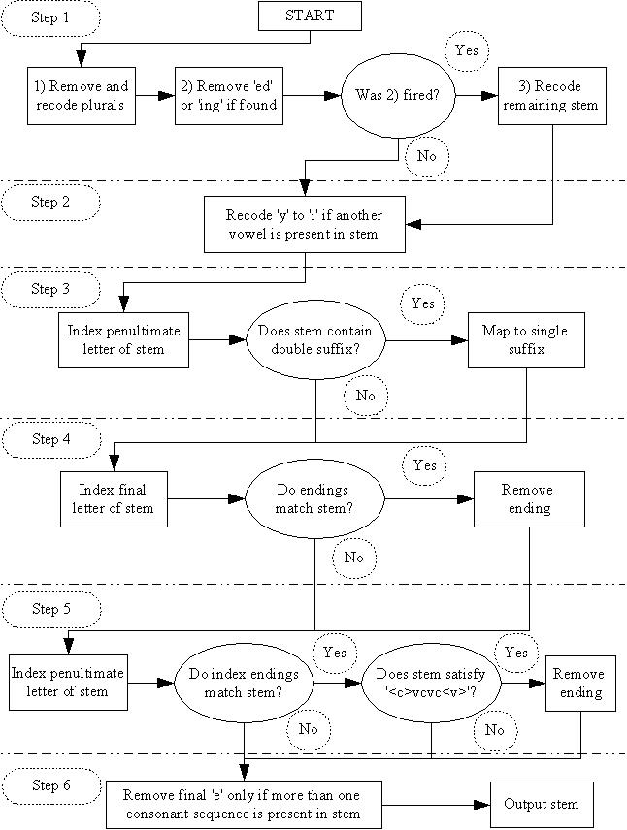
Porter’s Stemming Algorithm

Slide 80
How to deal with other Common Terms?
Collection Frequency = what fraction of all documents contains term
CF
CF
Very uncommon
0%
Very common
100%

Slide 81
Inverse Document Frequency (IDF)
Let D2 set of all documents

Slide 82
Revisiting Similarity Measures
Similarity Measure sim(X,Y) | Evaluation for Binary Term Vectors | Evaluation for Weighted Term Vectors
Inner product
Dice coefficient
Cosine coefficient
Jaccard coefficient
Legend:
X=(x1,x2,…,xt)
= number of terms in X
=number of terms appearing jointly in X and Y
Table from:
Gerald Salton,
Automatic Text Processing
Page 318

Slide 83
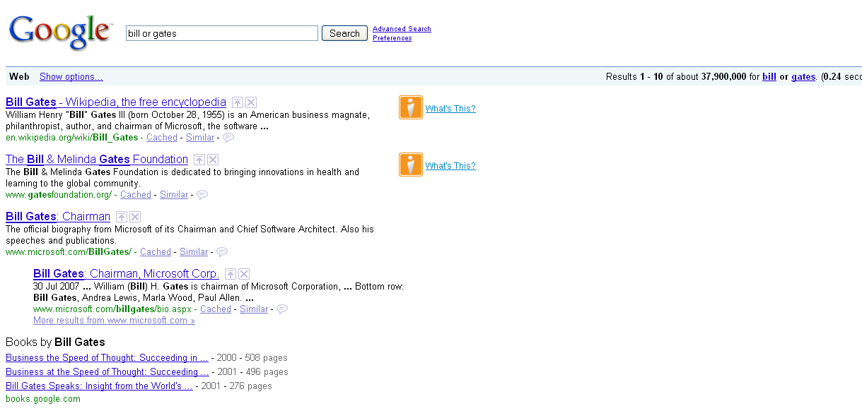
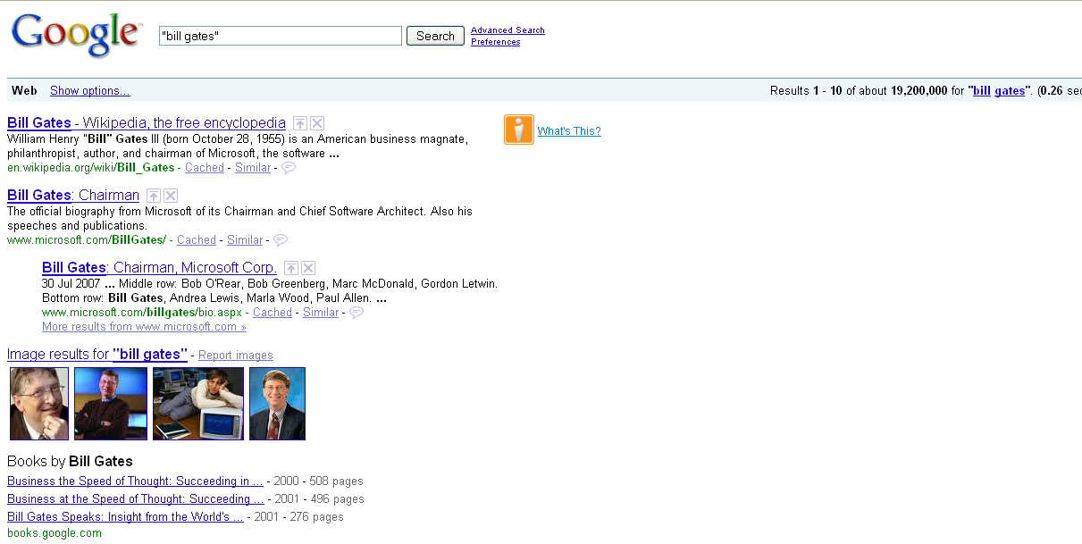
Phrase Recognition can Improve Decision and Recall
Searching:
bill or gates
vs.
“bill gates”

Slide 84
A Simple Phrase Recognition Algorithm
for each document d
for each k: 1 to m
for each step p of k consecutive terms
p = <t1, t2, …, tk>
countp ++
Declare all p with counts over a threshold to be phrases.

Slide 85
Outline
Introduction and Examples
Query Models
Implementation Issues
References

Slide 86
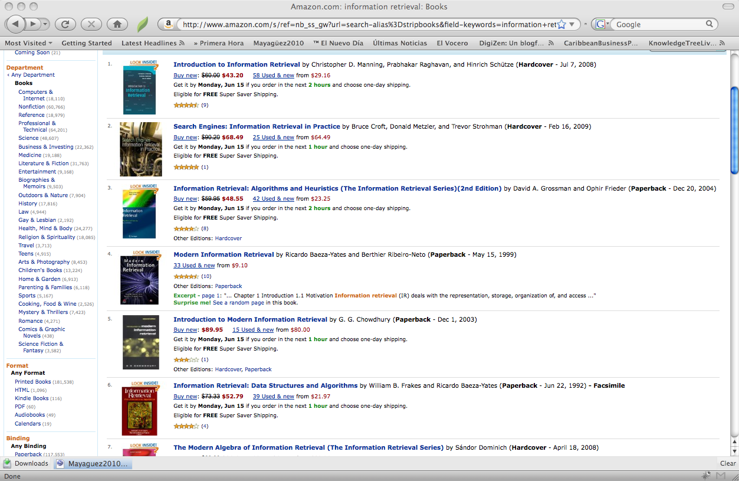
References
Gerald Salton, Automatic Text Processing
Baeza Yates, Information Retrieval Algorithms

