Slide 1
The following material is the result of a curriculum development effort to provide a set of courses to support bioinformatics efforts involving students from the biological sciences, computer science, and mathematics departments. They have been developed as a part of the NIH funded project “Assisting Bioinformatics Efforts at Minority Schools” (2T36 GM008789). The people involved with the curriculum development effort include:
Dr. Hugh B. Nicholas, Dr. Troy Wymore, Mr. Alexander Ropelewski and Dr. David Deerfield II, National Resource for Biomedical Supercomputing, Pittsburgh Supercomputing Center, Carnegie Mellon University.
Dr. Ricardo Gonzalez-Mendez, University of Puerto Rico Medical Sciences Campus.
Dr. Alade Tokuta, North Carolina Central University.
Dr. Jaime Seguel and Dr. Bienvenido Velez, University of Puerto Rico at Mayaguez.
Dr. Satish Bhalla, Johnson C. Smith University.
Unless otherwise specified, all the information contained within is Copyrighted © by Carnegie Mellon University. Permission is granted for use, modify, and reproduce these materials for teaching purposes.

Slide 2
This material is targeted towards students with a general background in Biology. It was developed to introduce biology students to the computational mathematical and biological issues surrounding bioinformatics. This specific lesson deals with the following fundamental topics:
  Computing for biologists
  Computer Science track
  This material has been developed by:
  Dr. Hugh B. Nicholas, Jr.
  National Center for Biomedical Supercomputing
  Pittsburgh Supercomputing Center
  Carnegie Mellon University

Slide 3
Bioinformatics Data Management
Lecture 1
Course Overview
The Need for Biological Information
  Bienvenido Vélez
  UPR Mayaguez
Reference: BioInformatics for Dummies

Slide 4
Course Outline
Course Overview
Introduction to Information Needs and Databases
Unstructured Data Repositories
  Query models and implementation issues
Structured Data Repositories
  Query models and implementation issues
Biology-specific Repositories
  Query models and implementation issues

Slide 5
Outline
Categories of Information Needs and Their Supporting Databases
  Reference vs. Discovery Needs
  General versus Domain Specific Databases
Overview of Current Biological Databases
The Future of Biological Databases and Tools:
  Integration of Biological Information
  Computer Assisted Bioinformatics (CAB)

Slide 6
Reference and discovery are two fundamentally different information needs
Reference:
  find something that I have seen before
  Example:
    find out who discovered a DNA sequence or protein
    Find some characteristic of a known sequence or protein
Discovery:
  find something new. Infer new knowledge.
  Examples:
    Find new sequences that evolved from known common ancestor
    Find sequences that may have similar function in other organisms
No single information system can support both information needs effectively

Slide 7
Finding Reference Information
Reference information searches can be accomplished:
  By key
    Find a DNA sequence by its accession number
  By attribute (exact)
    Find sequences belonging to C. Elegans
  By attribute (inexact)
    Find proteins related to some type of cancer

Slide 8
Discovering Information
By Association (similarity) vs. by Fr..?? ss by structure
Discovery searches can be accomplished:
  By similarity of:
    Structure
    Function
    Combination of the above

Slide 9
General Databases
Contain information on virtually any subject
Information exists in large variety of formats and styles:
  Images, web pages, emails, PDF’s, blog entries, forum entries, WIKI pages, etc
Provide a generic query model often based on term occurrence
  Find me everything that contains the terms “aldehyde dehydrogenase”
Pros: One stop shopping for information
Cons: Hard to exploit the nature of information in order to speed up the search. May yield lots of irrelevant information

Slide 10
Domain-specific Databases
Contain information specific to a relatively small knowledge domain (e.g. DNA sequences)
Information appears in somewhat homogeneous form
Provide a specific query model that can exploit the particularities of the information
Pros: Specific questions can be answered quickly
Cons: User must often integrate results from multiple specific databases in order to answer a more general question

Slide 11
Definition: Biological Database
Any repository containing Biological information which can be used to:
  assess the current state of knowledge
  Formulate new scientific hypotheses
  Validate these hypotheses
Some Examples of Biological Databases
Sequence
Structure
Family/Domain
Species
Taxonomy
Function/Pathway
Disease/Variation
Publication Journal
And many other ways

Slide 12
How is Biological Information Stored?
From a computer-science perspective, there are several ways that data can be organized and stored:
  In a flat text file
  In a spreadsheet
  In an image
  In an video animation
  In a relational database
  In a networked (hyperlinked) model
  In any combination of the above
  Others

Slide 13
Sequence Data Libraries
Organized according to sequence
When one talks about “searching sequence databases” these are the libraries that they are searching
Main sources for sequence libraries are direct submissions from individual researchers, genome sequencing projects, patent applications and other public resources.
  Genbank, EMBL, and the DNA Database of Japan (DDBJ) are examples of annotated collections publicly available DNA sequences.
  The Universal Protein Resource (UniProt) is a comprehensive resource for protein sequence and annotation data

Slide 14
Structural Data Libraries
Contain information about the (3-dimensional) structure of the molecule
Main sources of structural data are direct submissions from researchers. Data can be submitted via a variety of experimental techniques including
  X-ray crystallography
  NMR structure depositions.
  EM structure depositions.
  Other methods (including Electron diffraction, Fiber diffraction).
The Protein Data Bank and the Cambridge Structural Database are two well-known repositories of structural information

Slide 15
Family and Domain Libraries
Typically built from sets of related sequences and contain information about the residues that are essential to the structure/function of the sequences
Used to:
  Generate a hypothesis that the query sequence has the same structure/function as the matching group of sequences.
  Quickly identify a good group of sequences known to share a biological relationship.
Some examples:
  PFAM, Prosite, BLOCKS, PRINTS

Slide 16
Species Libraries
Goal is to collect and organize a variety of information concerning the genome of a particular species
Usually each species has its own portal to access information such as genomic-scale datasets for the species.
Examples:
  EuPathDB - Eukaryotic Pathogens Database (Cryptosporidium, Giardia, Plasmodium, Toxoplasma and Trichomonas)
  Saccharomyces Genome Database
  Rat Genome Database
  Candida Genome Database

Slide 17
Taxonomy Libraries
The science of naming and classifying organisms
Taxonomy is organized in a tree structure, which represents the taxonomic lineage.
Bottom level leafs represents species or sub-species
Top level nodes represent higher ranks like phylum, order and family
Examples:
  NEWT
  NCBI Taxonomy

Slide 18
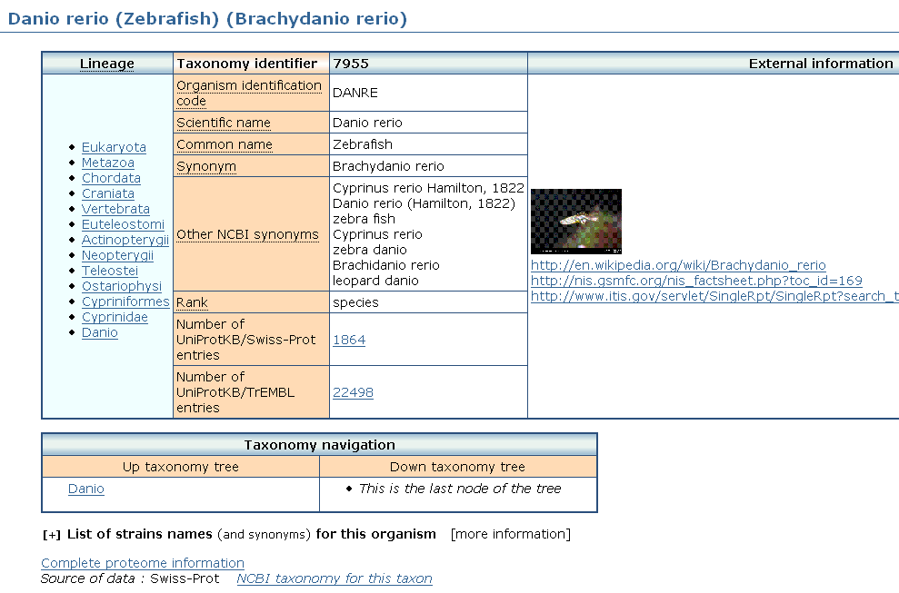
Taxonomy Libraries - NEWT

Slide 19
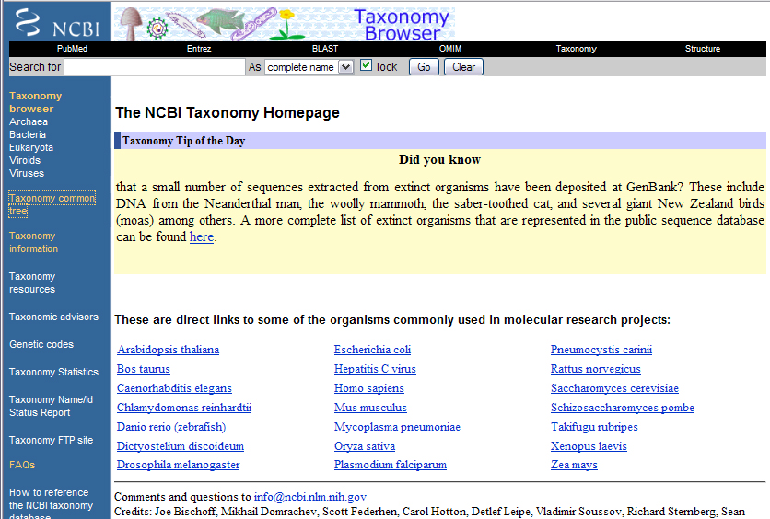
NCBI Taxonomy Browser

Slide 20
Function/Pathway
Collection of pathway maps representing our knowledge on the molecular interaction and reaction networks for:
  Metabolism
  Genetic Information Processing
  Environmental Information Processing
  Cellular Processes
  Human Diseases
  Drug Development
Examples:
  KEGG Pathway Database
  NCI-Nature Pathway Interaction Database

Slide 21
Disease/Variation
Catalogs of genes involving variations including within populations and among populations in different parts of the world as well as genetic disorders and other diseases.
Examples:
  OMIM, Online Mendelian Inheritance in Man - focuses primarily on inherited, or heritable, genetic diseases in humans
  HapMap - a catalog of common genetic variants that occur in humans.

Slide 22
Journal
U.S. National Library of Medicine
PubMed is the premiere resources for scientific literature relevant to the biomedical sciences.
Includes over 18 million citations from MEDLINE and other life science journals for articles back to the 1950s.
PubMed includes links to full text articles and other related resources.
Common uses of PubMed:
  Find journal articles that describe the structure/function/evolution of sequences that you are interested in
  Find out if anyone has already done the work that you are proposing

Slide 23
Current databases are loosely integrated
In order to prove a hypothesis one must often collect information from several independent databases and tools
Lots of time are spent converting data back and forth among the multiple specific formats required by the various tools and databases
Discovery process may take a long time, weeks or even months, to complete and tools do not effectively assist the scientist in saving intermediate results in order to continue the search from that point at a later time.
What has been done about this?

Slide 24
Integrated Information Resources
Integrated resources typically use a combination of relational databases and hyperlinks to databases maintained by others to provide more information than any single data source can provide
Many Examples:
  NCBI Entrez – NCBI’s cross-database tool
  iProClass - proteins with links to over 90 biological databases. including databases for protein families, functions and pathways, interactions, structures and structural classifications, genes and genomes, ontologies, literature, and taxonomy
  InterPro - Integrated Resource Of Protein Domains And Functional Sites.

Slide 25
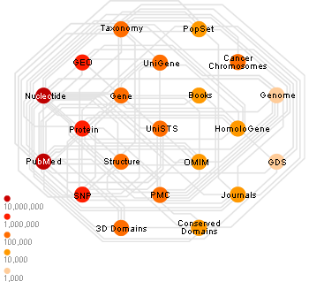
NCBI Entrez Data Integration

Slide 26
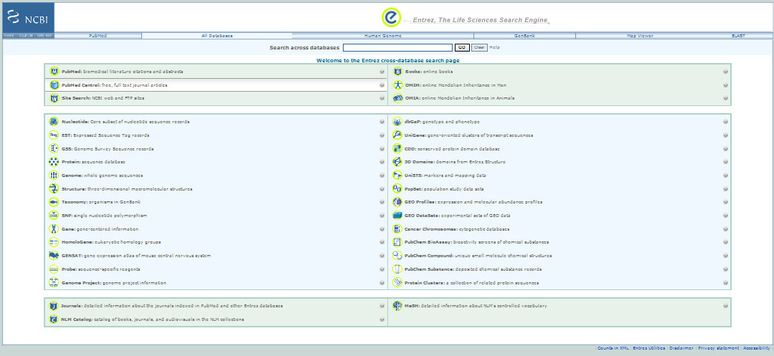
NCBI Entrez

Slide 27
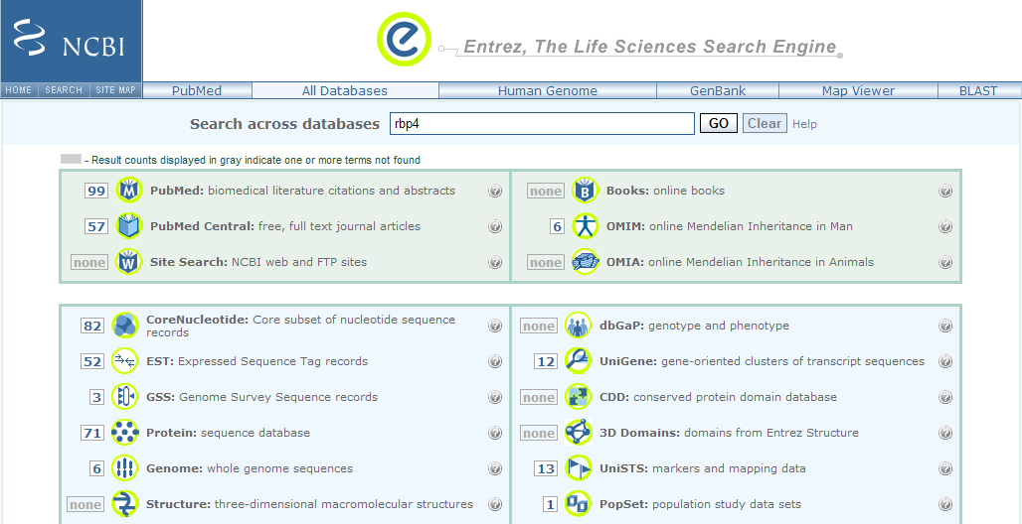
NCBI Entrez Results

Slide 28
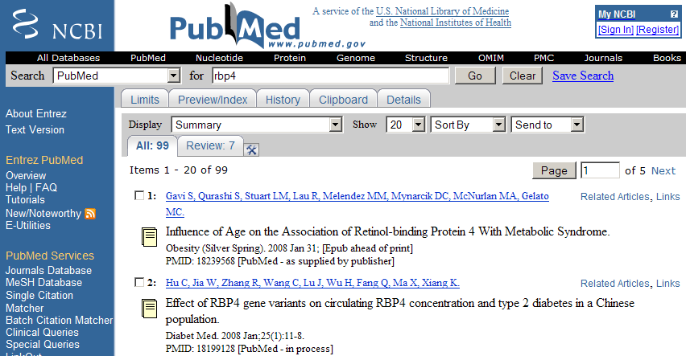
NCBI Entrez PubMed Results

Slide 29
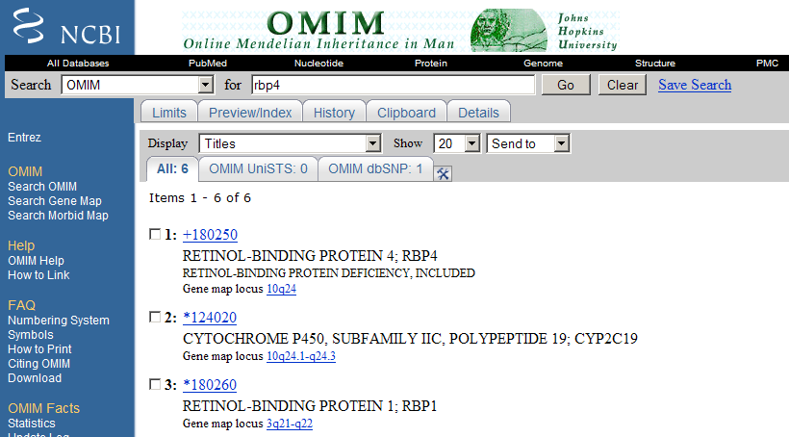
NCBI Entrez OMIM Results

Slide 30
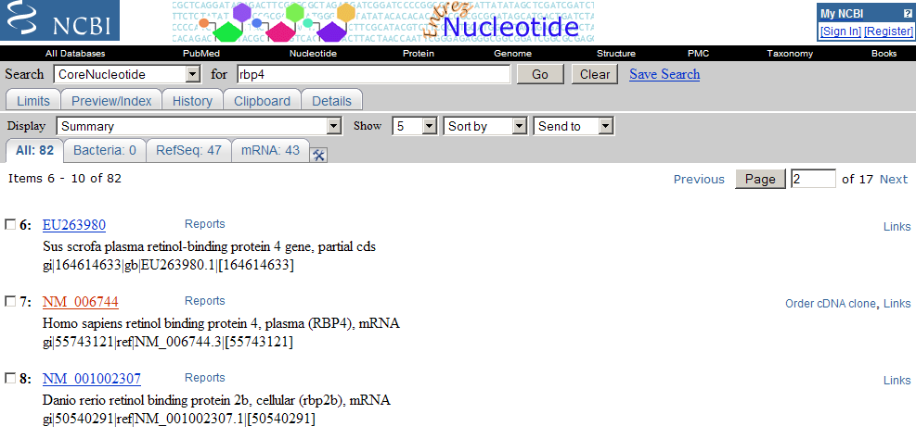
NCBI Entrez Core Nucleotide Results

Slide 31
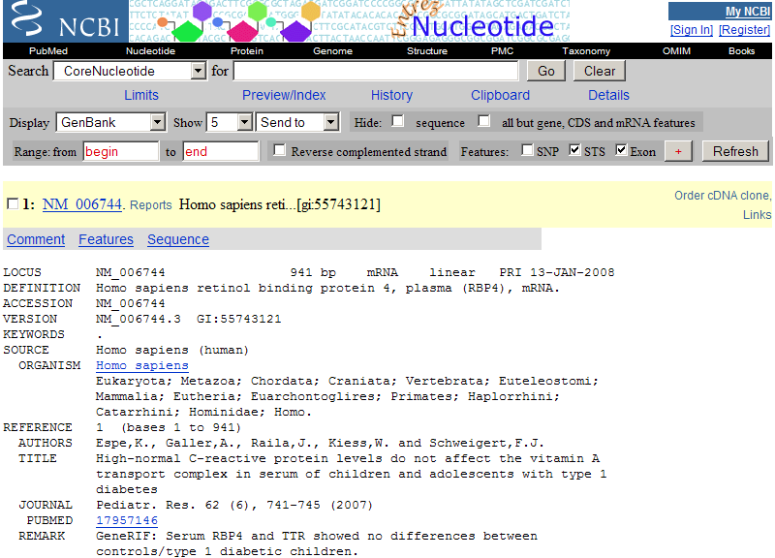
NCBI Entrez Core Nucleotide Results

Slide 32
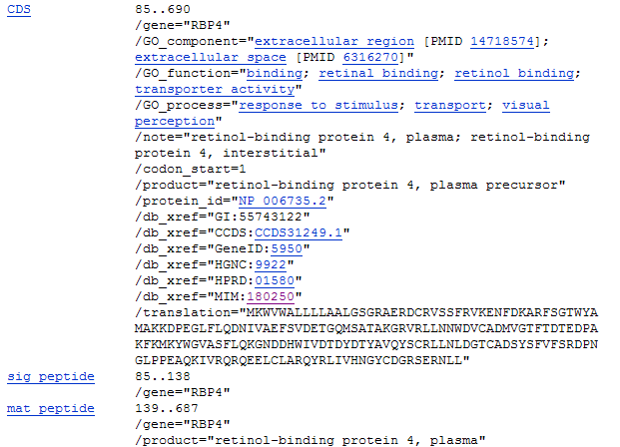
NCBI Entrez Core Nucleotide Results

Slide 33
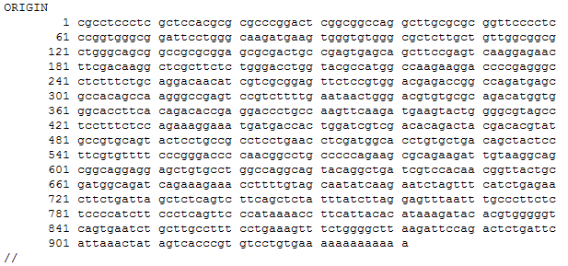
NCBI Entrez Core Nucleotide Results

Slide 34
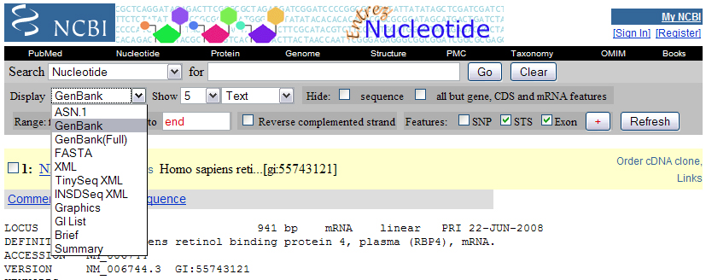
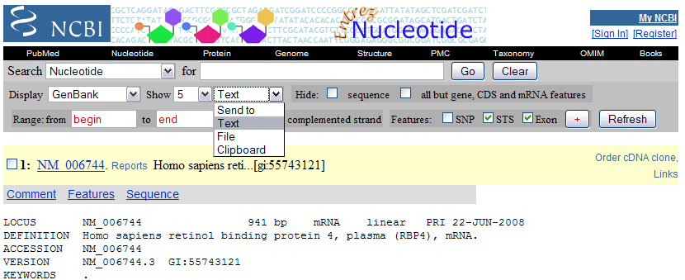
NCBI Entrez Saving Sequences

Slide 35
NCBI Sequence Identifiers
Accession Number: unique identifier given to a sequence when it is submitted to one of the DNA repositories (GenBank, EMBL, DDBJ). These identifiers follow an accession.version format. Updates increment the version, while the accession remains constant.
GI: GenInfo Identifier. If a sequence changes a new GI number will be assigned. A separate GI number is also assigned to each protein translation.

Slide 36
iProClass Protein Knowledgebase
Protein centric
Links to over 90 biological data libraries
Goal is to provide a comprehensive picture of protein properties that may lead to functional inference for previously uncharacterized "hypothetical" proteins and protein groups.
Uses both data warehousing in relational databases as well as hypertext links to outside data sources

Slide 37
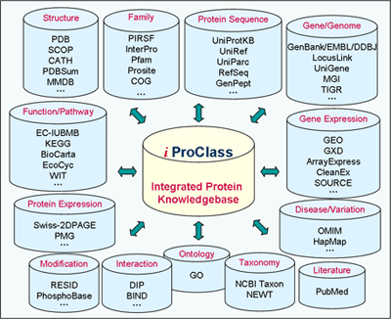
iProclass Integration

Slide 38
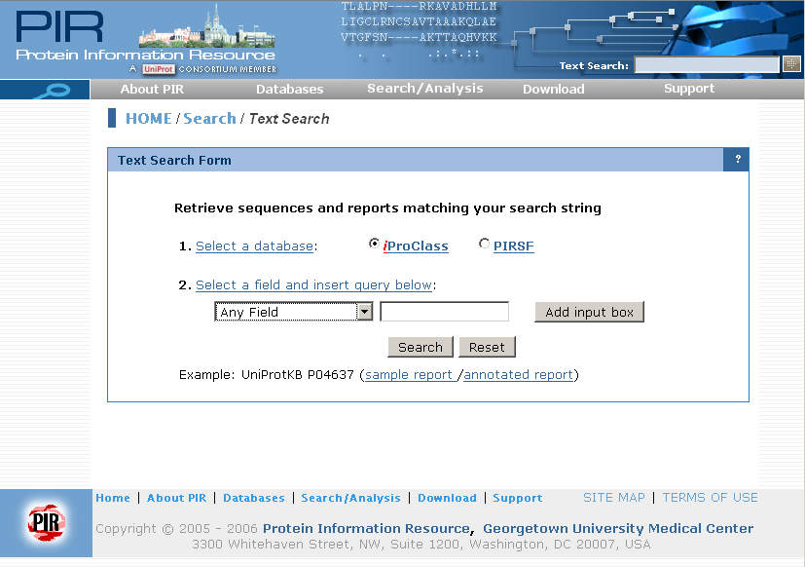
iProclass Search Form

Slide 39
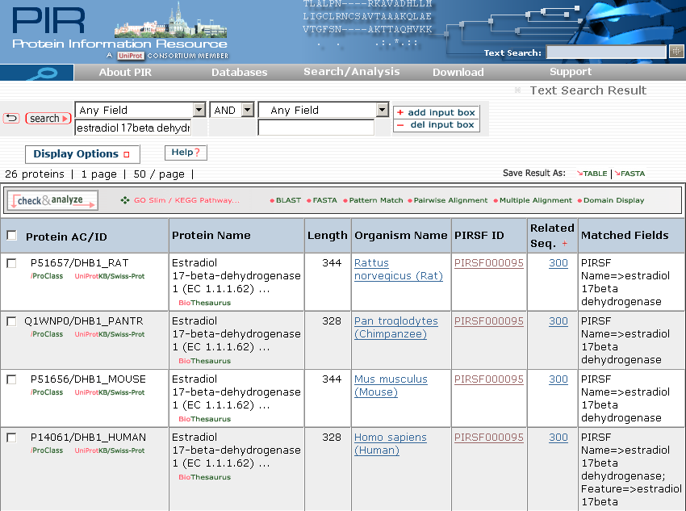
iProclass Results

Slide 40
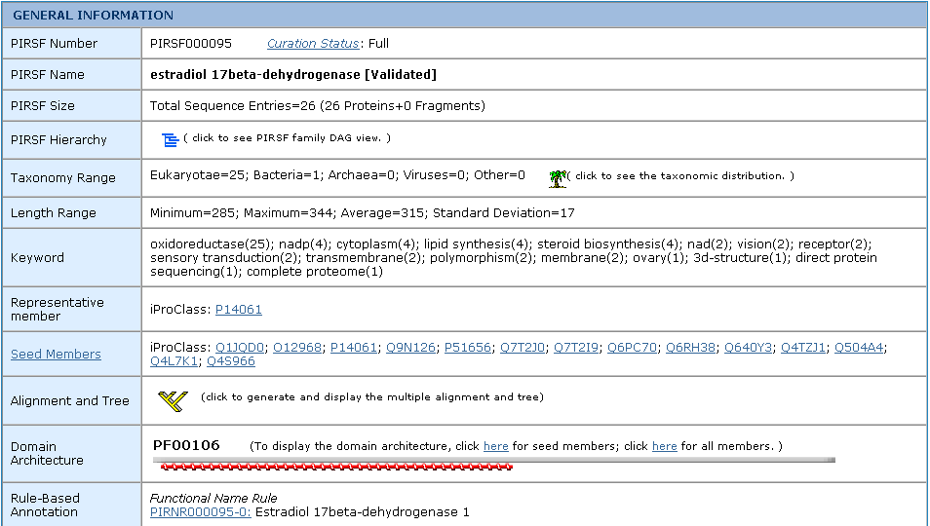
iProClass SuperFamily Summary

Slide 41
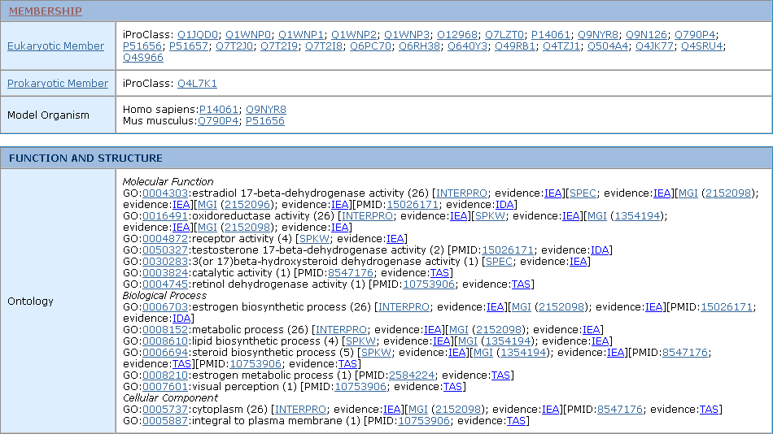
iProClass SuperFamily Summary

Slide 42
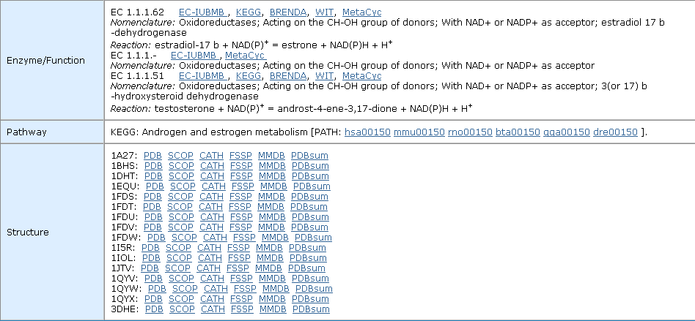
iProClass SuperFamily Summary

Slide 43
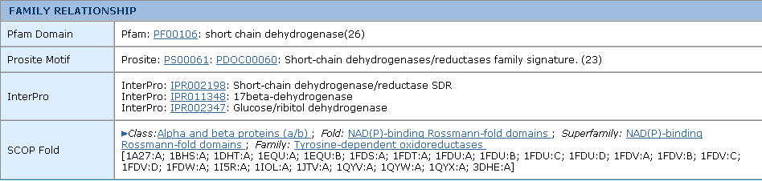
iProClass SuperFamily Summary

Slide 44
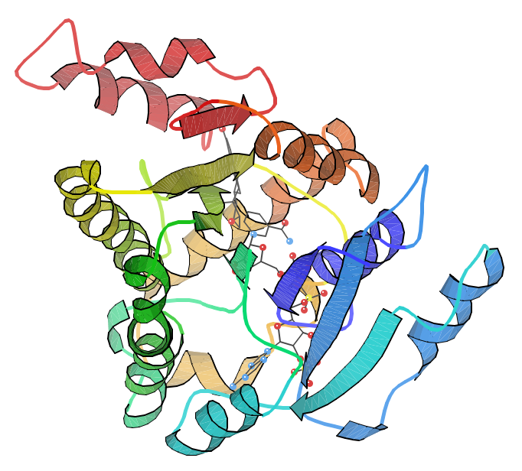
iProClass PDB Structure 1a27

Slide 45
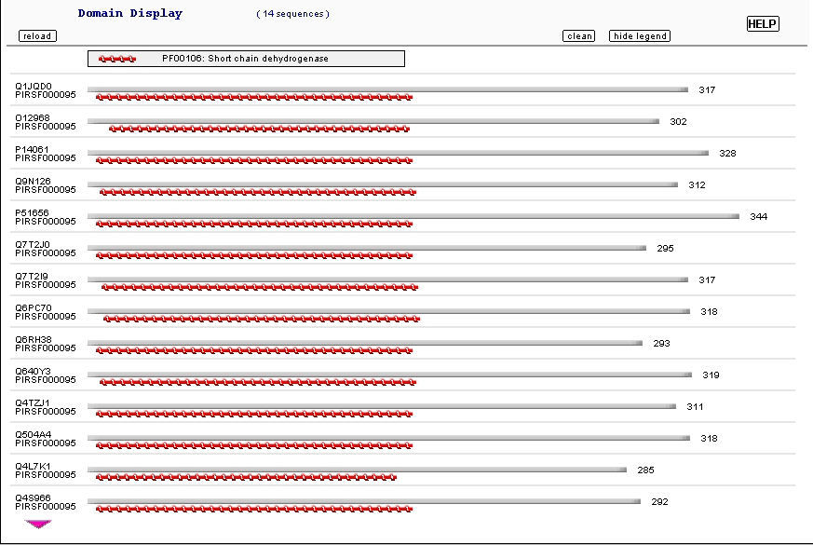
iProClass Domain Architecture

Slide 46
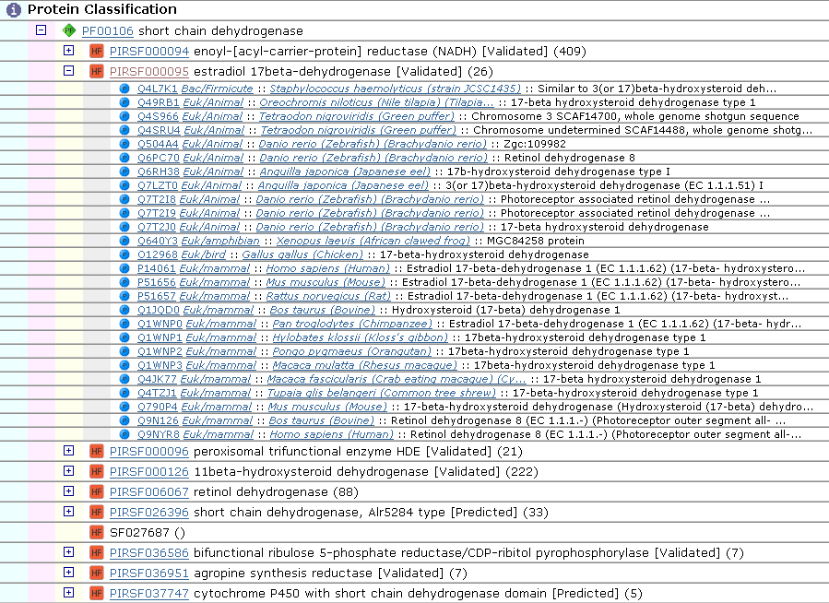
PIRSF Family Hierarchy

Slide 47
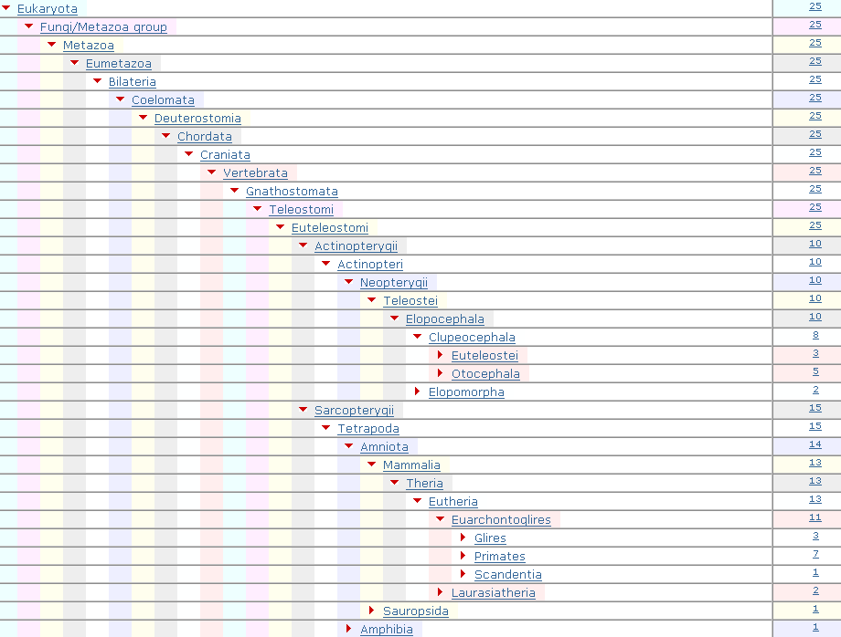
iProClass Taxonomy Nodes

Slide 48
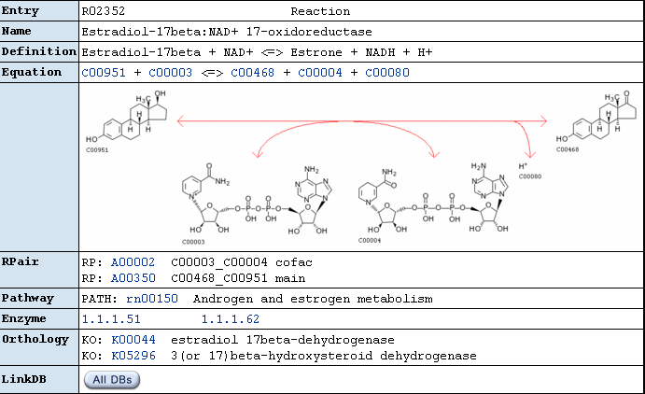
iProClass Enzyme Function: KEGG

Slide 49
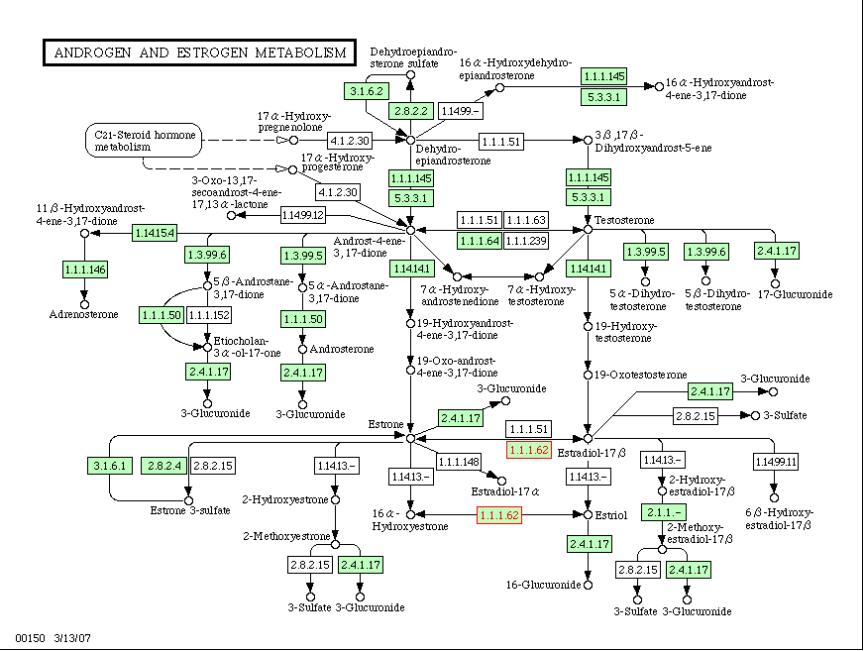
iProClass Pathway: KEGG

Slide 50
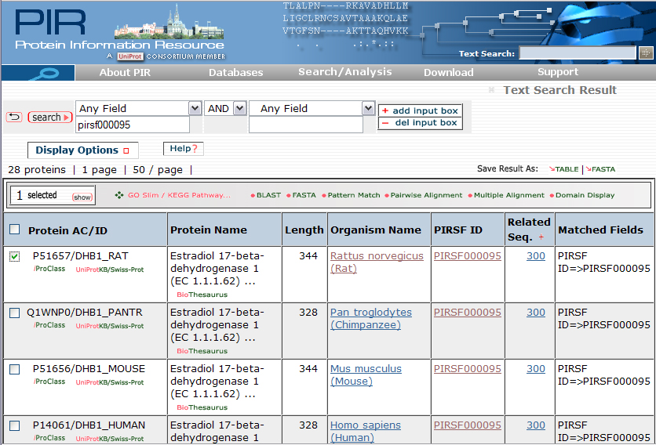
iProClass: Saving Sequences
Save
Format
Check
Entries

Slide 51
InterPro
Integrated resource of protein families, domains, repeats and sites from member databases (PROSITE, Pfam, Prints, ProDom, SMART and TIGRFAMs).
Member databases represent features in different ways: Some use hidden Markov models, some use position specific scoring meaticies, some use ambiguous consensus patterns.
Easy way to search several libraries at once with a query.

Slide 52
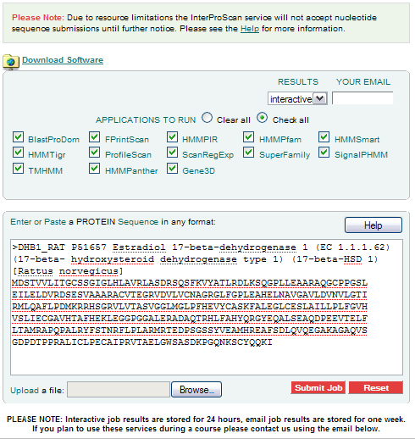
InterPro – Searching with InterProScan

Slide 53
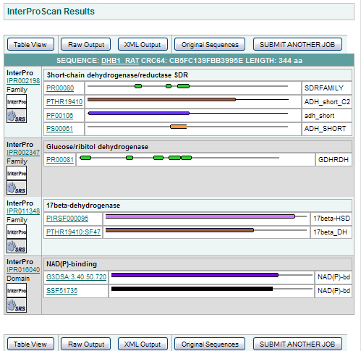
InterPro - InterProScan Results

Slide 54
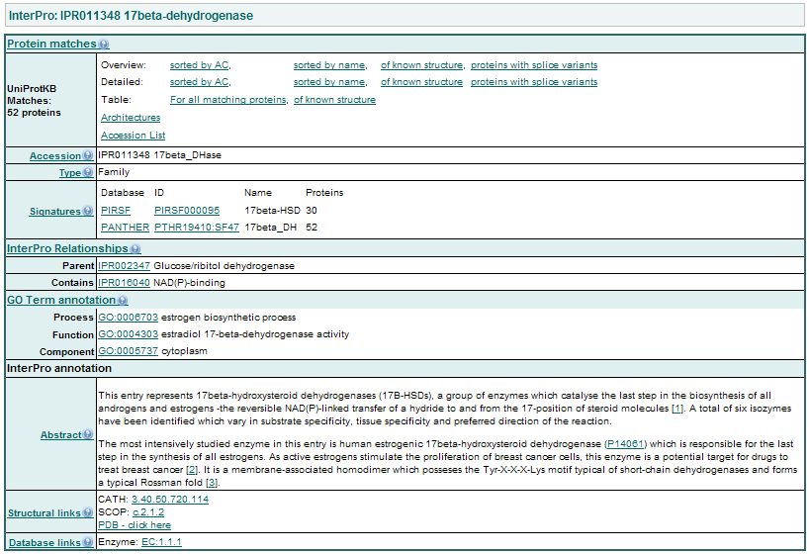
InterPro - InterProScan Results

Slide 55
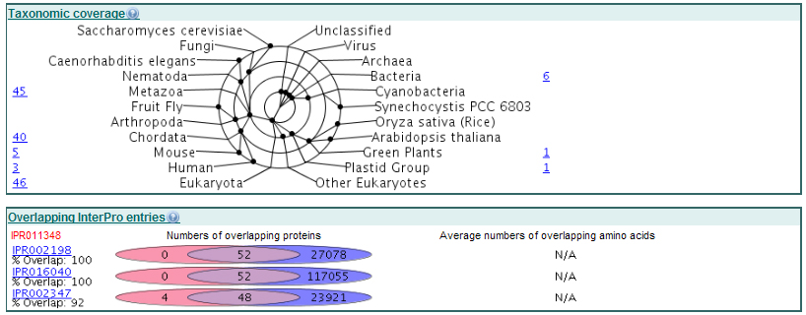
InterPro - InterProScan Results

Slide 56
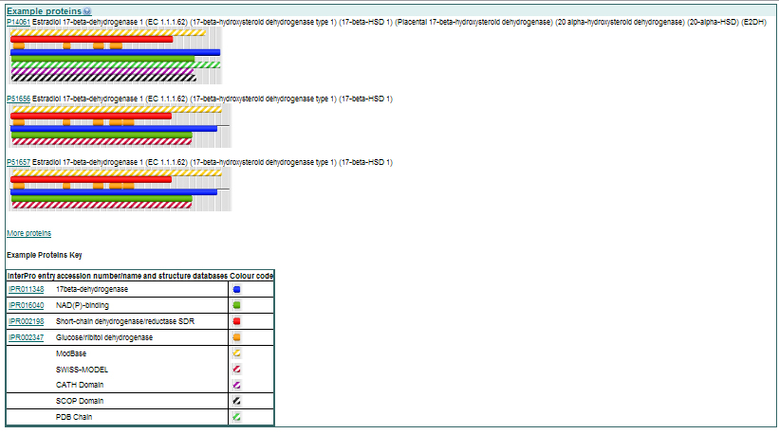
InterPro - InterProScan Results

Slide 57
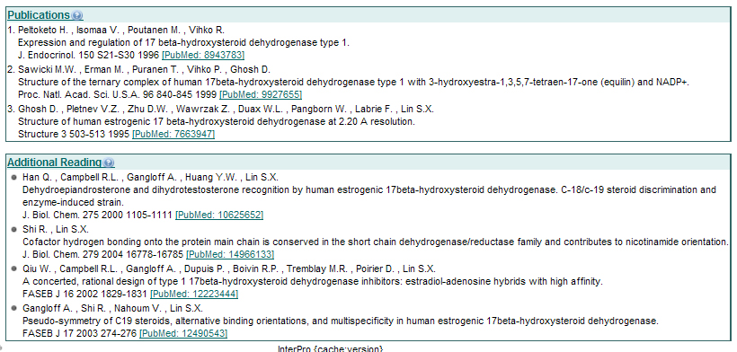
InterPro - InterProScan Results

Slide 58
A Vision:
Computer Assisted Bioinformatics
Goal
  The computer assists the scientist in the collection of all bioinformatics information relevant to the hypothesis at hand
A single software application that can:
    Understand multiple data formats specifically devised to represent structure, function, metabolism, evolution, etc.
    Assist scientists in creating and maintaining relationships among different types of information collected from multiple sources
    Support simultaneous searches across multiple data sources of a similar nature (e.g. multiple sequence databases)
Remains an Open Research Problem

